Slide 1




HOW TO ENTER EARLY WITHDRAWAL DATA
Trial protocol code: ISRCTN30952488
Version 2, 21 Nov 2017

Slide 2
Early Withdrawal Form
If a patient chooses not to continue with the trial, a GP withdraws a patient from the trial, a patient dies, or a patient is lost to follow-up, an end of trial/early withdrawal form must be completed
This is to be completed at the point of confirmed withdrawal
In all cases, unless the patient requests otherwise, all data collected up until the point of withdrawal will be used as trial data.

Slide 3
Early Withdrawal Form
Form can be found in the Protocol, Appendix 3
Section B to be completed by the Research Nurse / GP
Direct database entry
Must be verifiable from medical records

Slide 4
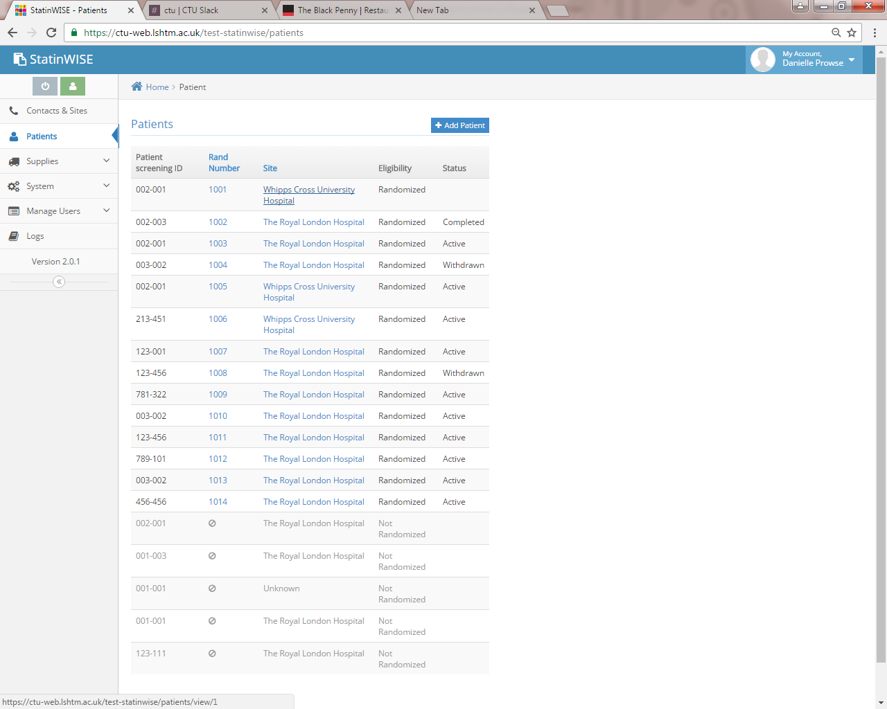
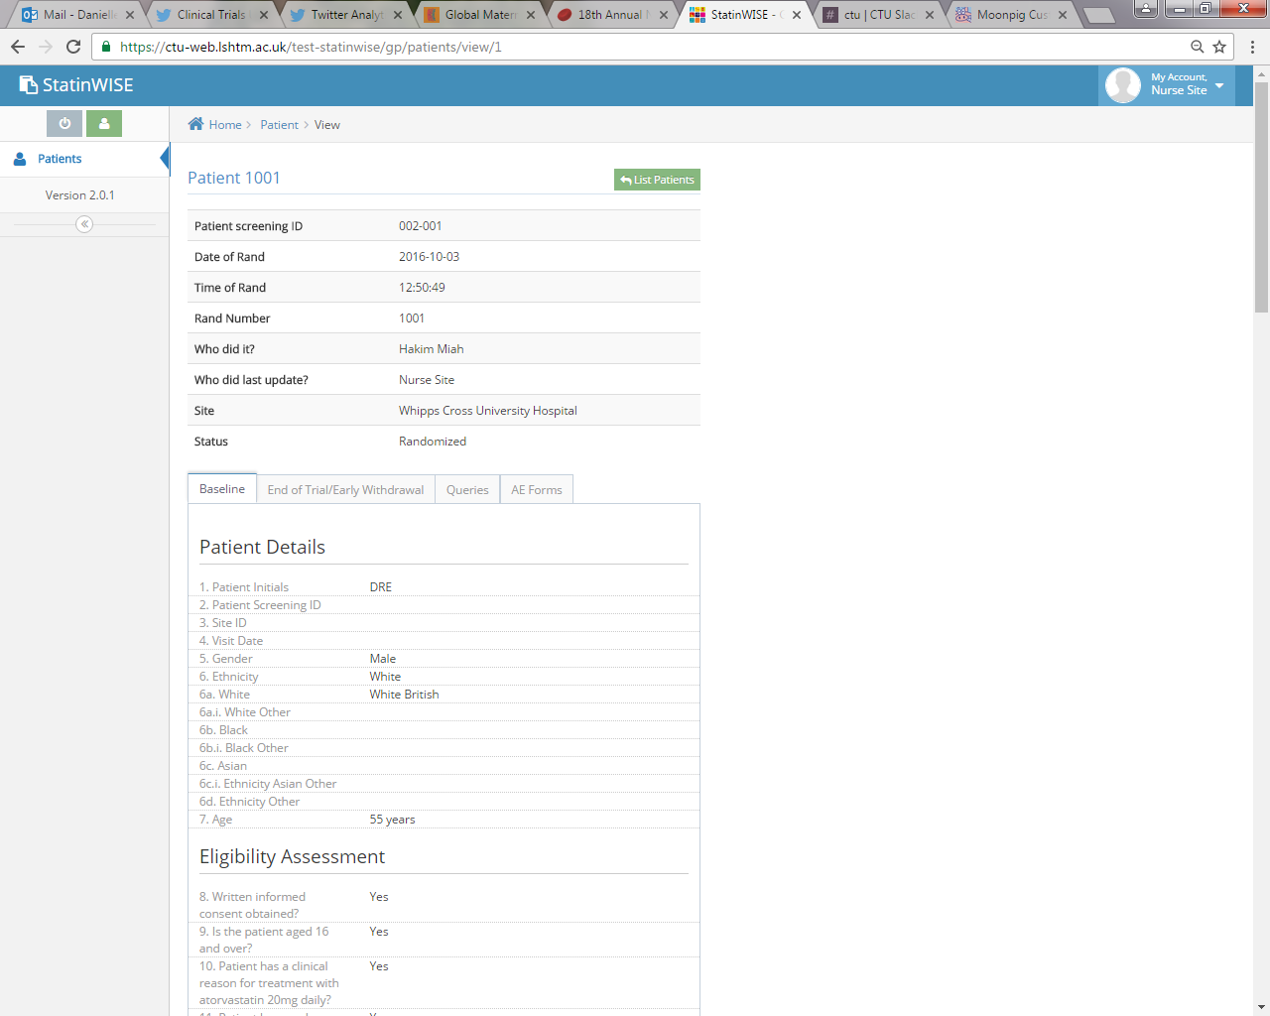
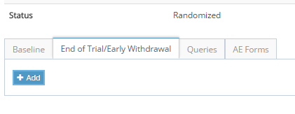
How to complete the early withdrawal form?
Select the patient that requires withdrawal
Select the end of trial/early withdrawal tab then add
User to log into database
Complete the form then submit

Slide 5
How to complete the early withdrawal form?
Select the main reason why patient did not complete the trial to month 15 from:
  Lost to follow up
  Early withdrawal (by patient or GP)
  Death

Slide 6
1. Lost to follow up
Contact with a patient may be lost over the course of the trial
The trial staff will attempt to re-establish communication
If contact cannot be re-established despite reasonable attempts, the patient is considered lost to follow up
Where a patient is lost to follow up the following questions are to be completed on the early withdrawal form:
  Date of last contact with patient
  Has the patient received individual trial results

Slide 7
2. Early withdrawal
Patients may withdraw from the trial because:
  Patient does not want to take part anymore and has withdrawn consent
  Patient has intolerable muscle symptoms
  GP has prescribed another medication and/or has advised that the patient should stop taking study treatment
  Patient no longer fulfils the eligibility criteria
If this happens, the following questions are to be completed on the early withdrawal form:
  Reason for withdrawal should be provided
  Patient should contact GP to discuss reason for withdrawal. A date for this is to be provided or if this has not taken place, site trial staff are to remind patient to book this appointment
  Patient (where applicable) will receive their personalised results. State the date this has happened, or expected appointment date.

Slide 8
3. Patient died
Where a patient has died, the following questions are to be completed on the early withdrawal form:
  Date of death required
  Cause of death required as per patients autopsy report or clinical judgement if autopsy is not available
  Date SAE form was completed (if applicable)

Slide 9
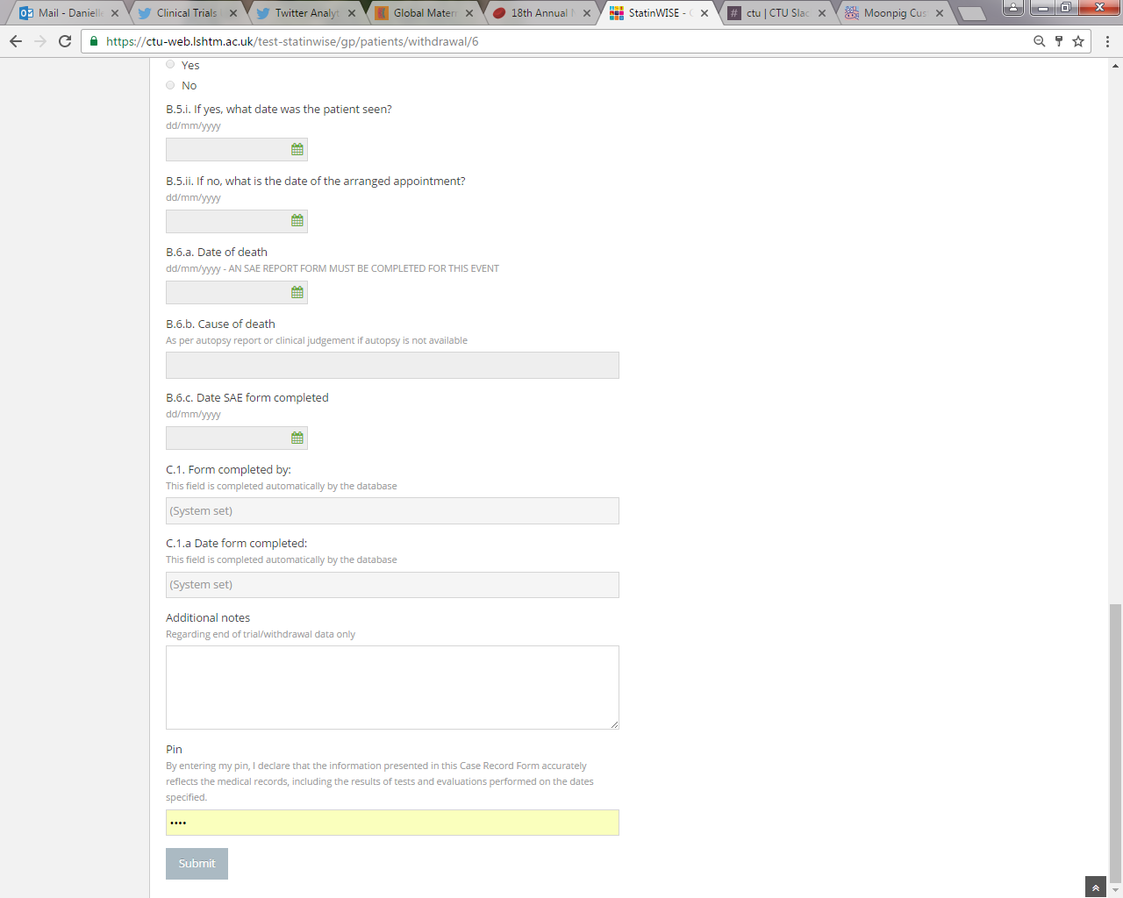
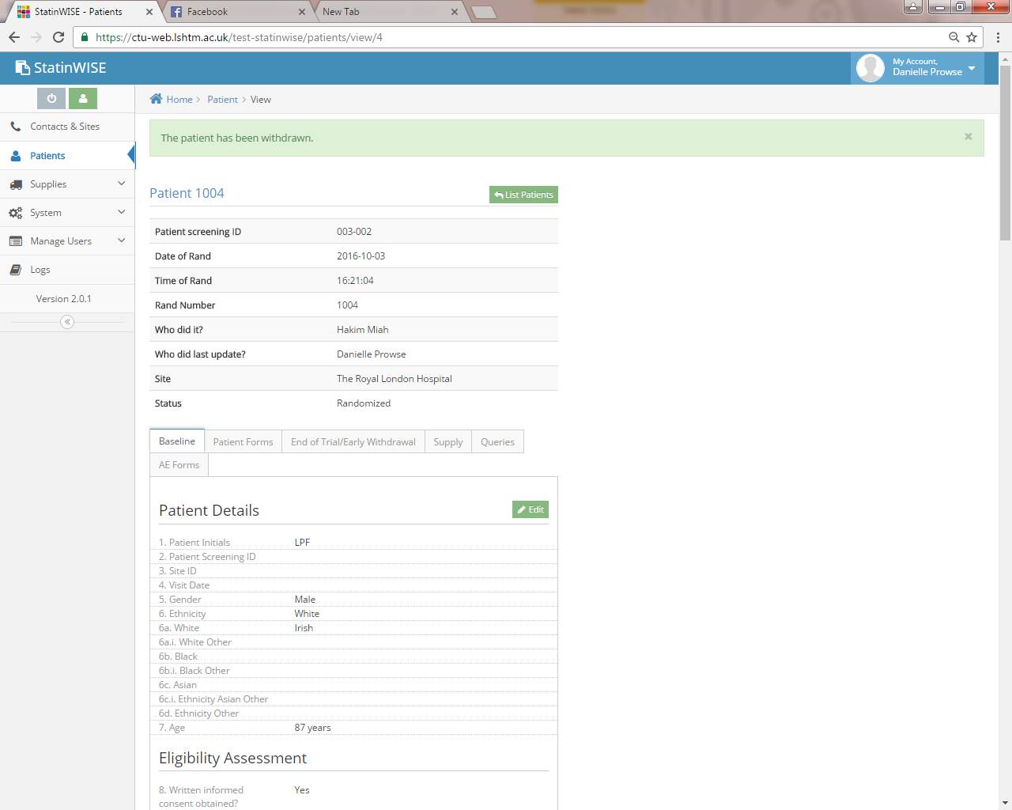
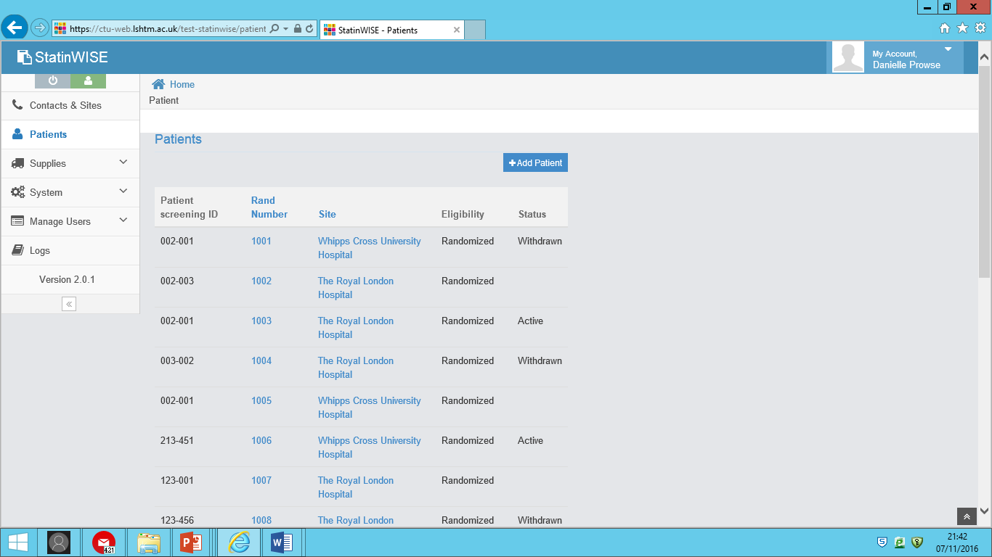
Submission of the early withdrawal form
Use the notes section to add any additional comments regarding the withdrawal
To submit site trial staff must enter their personal pin to confirm data entered is accurate in line with medical records
The status of the patient changes to ‘withdrawn’. This disables all further reminders/alerts to patients
After submission, data can be viewed but not edited. Any data amendment requests must be sent to the trial team to action

Slide 10


CONTACT US
London School of Hygiene & Tropical Medicine
Room 180, Keppel Street, London WC1E 7HT
Tel +44(0)20 7299 4684
Fax +44(0)20 7299 4663
Email: statinwise@Lshtm.ac.uk

