Slide 1




HOW TO CONSENT A PATIENT?
Trial protocol code: ISRCTN30952488
Version 2, 19 Oct 2017

Slide 2
What is valid informed consent?
Informed consent is based on respect for the individual and in particular the individual's autonomy / capacity and right to define his or her own goals and make choices designed to achieve those goals for his/her own life
This right is well established in many national laws
Informed consent means more than simply obtaining the signature of the potential research participant
It is a process that involves:
  conveying accurate and relevant information about the study and its purpose;
  disclosing known risks, benefits, alternatives and procedures;
  answering questions;
  enabling the potential participant to make an informed decision about whether to participate, including enough time to think about and discuss participation with trusted individuals.

Slide 3

What is valid informed consent?
In order for consent to be valid it should be based on the following
critical elements:
Full Capacity: The participant must have the mental capacity to understand the information provided, appreciate how it is relevant to their circumstances, and be able to made a reasoned decision about whether to participate in a particular study.
Fully Informed: The research team must disclose all relevant information to the potential participant. The information in this study must comply with ICH-GCP requirements. The minimum information for a valid informed consent is the approved version of the Patient Information Sheet (PIS) and Informed Consent Form (ICF).
Understanding: The potential participant must comprehend the information. The research team must evaluate the potential participant‘s
ability to understand the proposed
intervention in the study.

Slide 4
What is valid informed consent?
Agree: The participant must agree to the proposed intervention and procedures in the research study
Voluntary: The participant's agreement must be voluntary and free from coercion
Freedom to withdraw: Participants must be informed that even after they have made a voluntary agreement to participate in the study, they may withdraw their consent at any time without penalty

Slide 5
What is valid informed consent?
If a person is asked to sign a written consent form, then it is assumed that:
1. The person has the capacity to do so
2. The delegated site trial staff member has disclosed all information needed for the person to understand the trial and its procedures
3. The consent is voluntary
4. The person is able to understand the information given and appreciates its relevance to their individual situation
5. The person then gives their authorisation allowing the trial team to carry out the trial procedures
To achieve this requires adequate time to be available for the person to read and understand the information, ask questions, reflect on their decision, talk with relatives or friends.
PISs should be posted to patients well in advance of any baseline visits
If the patient is identified from a consultation, remember to give adequate time for reading and understanding the PIS
Please remember that the consent process must not be viewed as only having a signed form

Slide 6
What does capacity to consent mean?
Capacity can be affected by several things including age, cognitive impairment, illness and treatments
In some studies, patients who do not have capacity can still participate
In the StatinWISE study, only capable adults can provide consent
Capable adult: Adults have the capacity to consent when they:
  possess sufficient mental capability to understand the information provided
  appreciate how it is relevant to their circumstances, and
  are able to make a reasoned decision about whether or not to participate in a particular study

Slide 7
Who can give valid informed consent?
In some studies, a representative acting for the patient can give consent on their behalf
In the StatinWISE study, the patient must give consent for their own participation in the trial
Consent must be recorded at the start of the Baseline visit, before any trial procedure is conducted

Slide 8
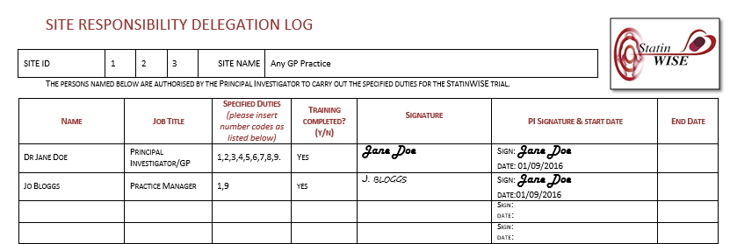
Who can take valid informed consent?
Consent must be taken by a medically qualified team member who has been delegated this task on the Site Responsibility Delegation log

Slide 9
Patient Information Sheet
The PIS will be posted to the patient’s address by the site trial team using the trial’s DOCMAIL account, using “mail out 2” and “mail out 3”
If the patient has expressed interest in StatinWISE after receiving “mail out 0” (the first communication about StatinWISE), they will need to be sent a PIS (this can be done by using “mail out 0a”
At the Baseline visit, considerable time may have passed since the
patient read the PIS, therefore, at the Baseline visit, the patient will be provided with information about the trial:
      Statins are a good way of reducing cardiovascular disease risk but we don’t know if they cause muscle symptoms
      A statin (atorvastatin 20mg) and a dummy capsule (called placebo) will be given in a random order (called sequence) to see if atorvastatin causes more muscle symptoms than the placebo

Slide 10
Patient Information sheet
    The sequence atorvastatin/placebo is unknown to the patients, the GP and the researchers
    Patient information gathered during the trial will be collected and sent to the Clinical Trials Unit (CTU) at the London School of Hygiene and Tropical Medicine
    The capsules to take will be posted to the patient’s address every 2 months (and will fit through a standard letterbox)
    The patient will complete a pain questionnaire every 2 months and receive their own results after 12 months’ participation
The optional genetic study should also be discussed – See presentation ‘The Optional Genetic Study’ for details and consent procedure
Notes:
Disagree

Slide 11
Consent procedures for StatinWISE
Once the patient indicates that s/he is happy to participate in the trial, consent can now be obtained and recorded in the consent form
Blank consent forms are in Folder 1, Section 13 of the ISF. Details on how to complete it are on the next slides
The original signed consent form should be filed in Folder 2, Section 15 of the ISF. The PIS and a copy of the signed consent form should be given to the patient
A copy of the signed consent form should also be placed in the patient’s medical records
A copy must also be scanned and emailed or faxed to the CTU so we can verify the consent and prepare the first treatment pack for mailing

Slide 12
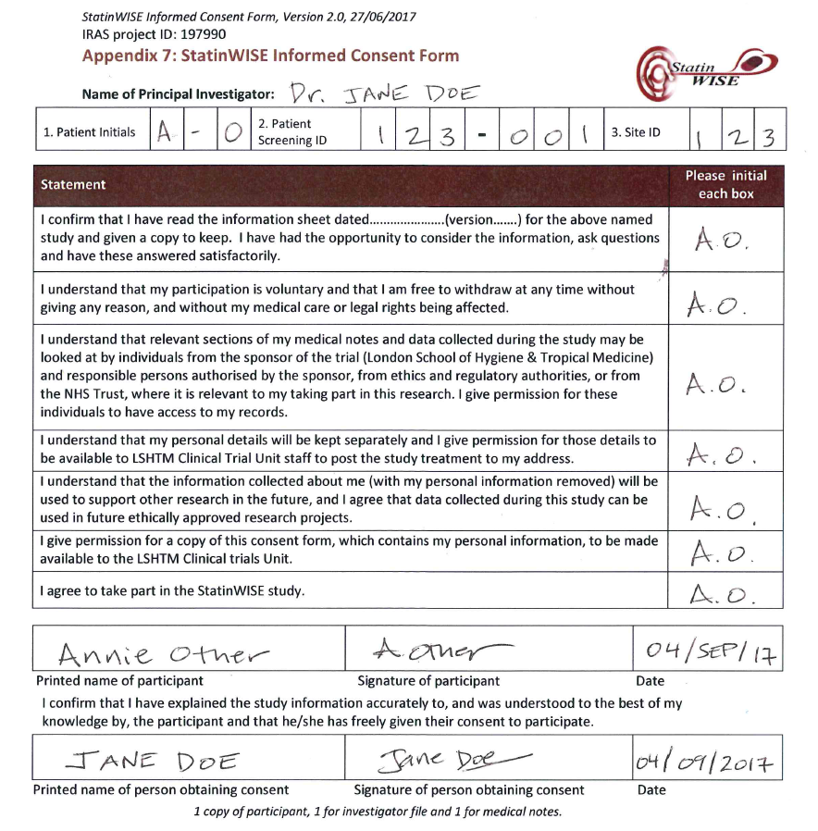
Completing the consent form
Top section completed by the person TAKING consent (doctor/nurse)
All boxes must be initialled by the patient.
The consenting patient must complete their name, date and sign.
The consent taker (doctor/nurse) must complete their name, date and sign.

Slide 13

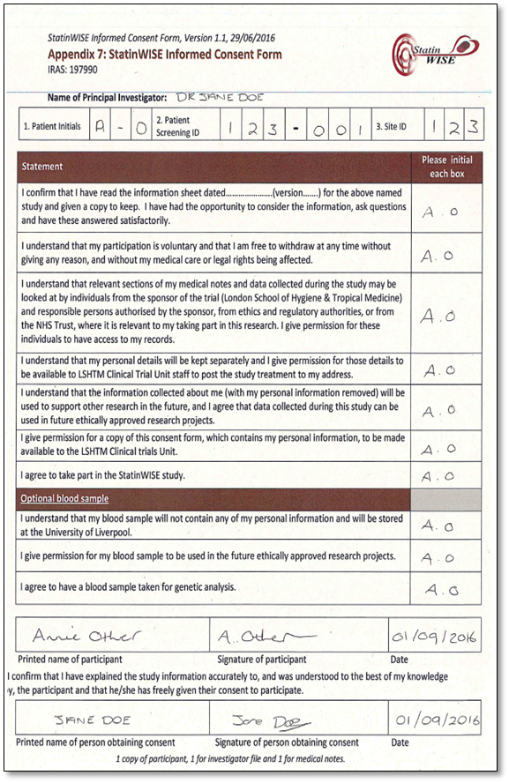
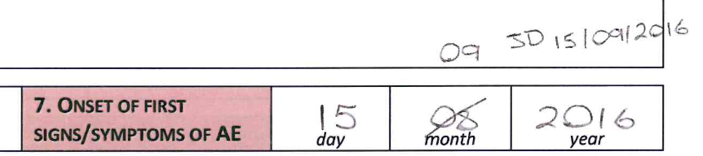
Common consent form errors
The name and/or date of the patient and consent taker have been written by the same person
  Each person must complete their own sections themselves
The date that the patient gave consent and the consent taker took consent are different
    The consent form should be signed by both parties at the same time
  The initial boxes at the end of each statement are blank, have been completed but not initialled e.g ticked instead, or the patient does not appear to have initialled them themselves
    The patient must initial these boxes themselves
  Header information is incomplete, or does not match information provided on the data forms
Mistakes have not been corrected properly
  To make a correction, draw a line through the error, write the correct information nearby, initial and date the correction

Slide 14


CONTACT US
London School of Hygiene & Tropical Medicine
Room 180, Keppel Street, London WC1E 7HT
Tel +44(0)20 7299 4684
Fax +44(0)20 7299 4663
Email: statinwise@Lshtm.ac.uk

