Slide 1
CONDUCTING THE TRIAL AT
YOUR SITE
Trial protocol code: ISRCTN30952488
Version 2, 19 Oct 2017

Slide 2
StatinWISE aims to:
Answer an important question for
public health
Answer the question for individual
patients
Bring together research and
care
Be as little work as possible for
GP Practices

Slide 3
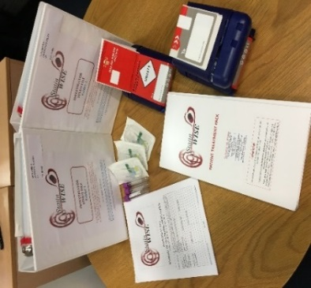
Training your StatinWISE team
We will provide all relevant training to site trial staff
Investigator Study file (ISF) and training materials
Search list in your practice’s system
DOCMAIL posting system
Blood sample test tubes for optional genetic study
We can provide a small filling cabinet to store the ISF and materials. Let us know if your site needs one!
The CTU will be responsible for treatment packs logistics because the CTU will post treatment packs directly to participants
Remember: the CTU Team are always available to answer any questions throughout the trial

Slide 4
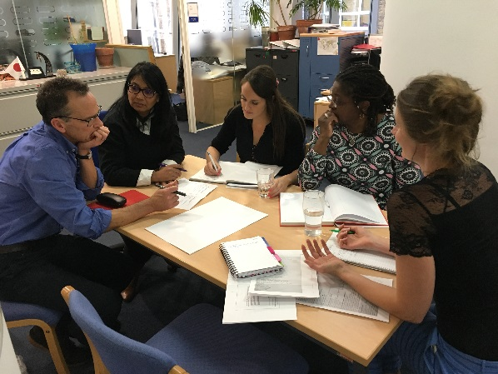
Managing the trial at your practice
Ensure your team knows:
Who is responsible for study task (delegation log); who is responsible if key team members are not there (e.g. lead research nurse / PI); let CTU know
Where (ISF) is kept and who is responsible
for maintaining it
How to recruit patients
How to assess eligibility
How to conduct screening calls
How to conduct baseline visits and consent procedures
How data forms should be completed
What to do if there is a serious adverse event
What to do if site trial staff need advice about the trial

Slide 5
Good Clinical Practice (GCP)
GCP is an international ethical and scientific quality standard for designing, conducting, recording and reporting trials that involve the participation of human subjects.
StatinWISE trials follows GCP guidelines
Free online training via our LSHTM website:
http://open.lshtm.ac.uk/enrol/index.php?id=6
A certificate will be issued upon successful completion
All staff involved in StatinWISE are required to complete GCP training prior to performing any trial related activity

Slide 6
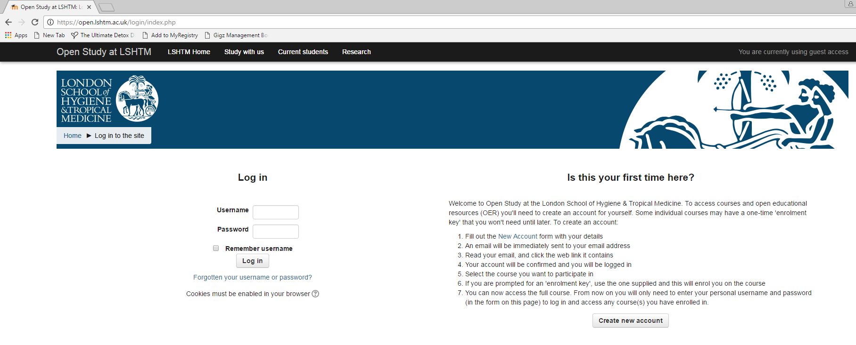
Either Log in or Create new account

Slide 7
Trial Specific Training
MANUAL OF OPERATING PROCEDURES (MOP)
Overview of the trial processes for principal investigators (PI), nurses, practice managers, monitors, other people with responsibilities in the trial
Important that all personnel involved are familiar with the sections relevant to their duties
PI needs to be familiar with the MOP
PRESENTATIONS
A selection of PowerPoint presentations explaining the trial procedures are provided on a portable storage device
SITE TRAINING
The CTU will organise face-to-face or remote training to explain the trial and its procedures prior to recruitment starting

Slide 8
Site Responsibility Delegation Log
This log is contained in Section 17 Site responsibilities of the ISF
List all members of site trial staff involved in the conduct of the trial e.g. doctors, nurses, practice managers, administrators (a copy must be sent to the CTU before study start up)
Add new staff members when they join the trial team (copy must be sent to the CTU following changes)
Note the end date for those who leave (copy sent to CTU)
When a team member leaves the trial, ensure they are replaced with a new team member and trained for their allocated tasks
A brief CV (signed and dated) for each person listed on the log is required to be filed in Section 17 (copy sent to CTU)

Slide 9
CONTACT US
London School of Hygiene & Tropical Medicine
Room 180, Keppel Street, London WC1E 7HT
Tel +44(0)20 7299 4684
Fax +44(0)20 7299 4663
Email: statinwise@Lshtm.ac.uk

