Slide 1




THE OPTIONAL GENETIC STUDY
Trial protocol code: ISRCTN30952488
Version 2, 19 Oct 2017

Slide 2
Why is the genetic study being done?
Research hinted at a genetic link between pain levels and statin therapy → SLCO1B1 variant
Further research required for definite answer
Blood samples required from affected population
StatinWISE trial provides a good opportunity to collect blood from the affected population
It is optional for StatinWISE participants to take part
A single test will be done on blood sample to check for presence of this variant
Sample will be stored without any personal information
No results will be fed-back to researchers, GPs, Nurses and Patients

Slide 3
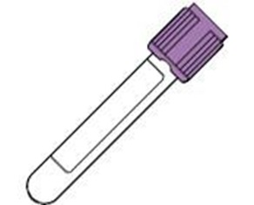
What does the genetic study involve for site trial staff?
Explain the study to patient
Obtain written consent if the patient is interested
Blood sample to be taken at Baseline Visit
  Only Mondays to Thursdays to avoid samples degrading without refrigeration during weekends
  If participant’s baseline visit is on a Friday, another appointment Mon-Thurs is required if they would like to participate in the optional genetic study
Genetic study ID number issued → anonymised
  No personal data is recorded/shared
Blood sample will be sent to University of Liverpool via royal mail using the Safebox provided

Slide 4
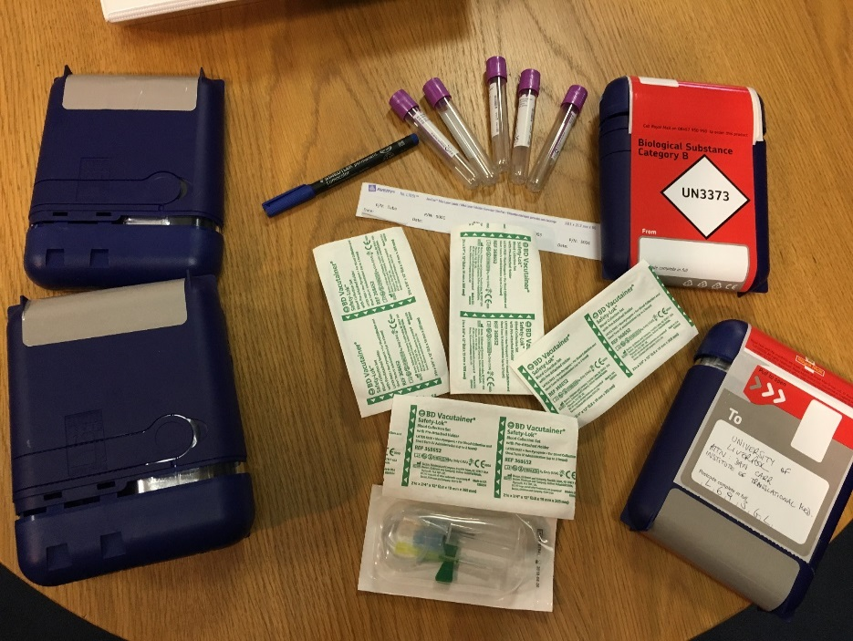
What sites will receive for the genetic study
5 EDTA VACUTAINER tubes (purple top)
1 permanent pen for writing the date of blood collection on the tube
5 Blood collection kit with pre-attached holder
5 Safeboxes labelled with recipient address and postage paid

Slide 5

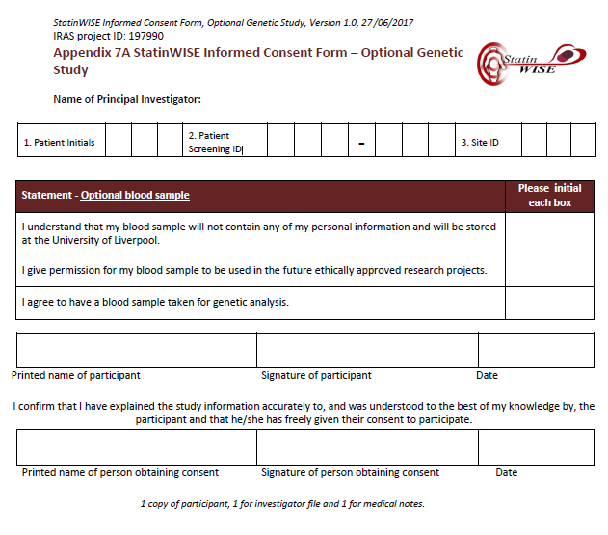
How to document consent for the genetic study?
Use the PIS and consent form for the optional genetic study. These are separate from the from the PIS and ICF for the main StatinWISE study
  A patient can decline the genetic study and still be a participant in the StatinWISE trial

Slide 6
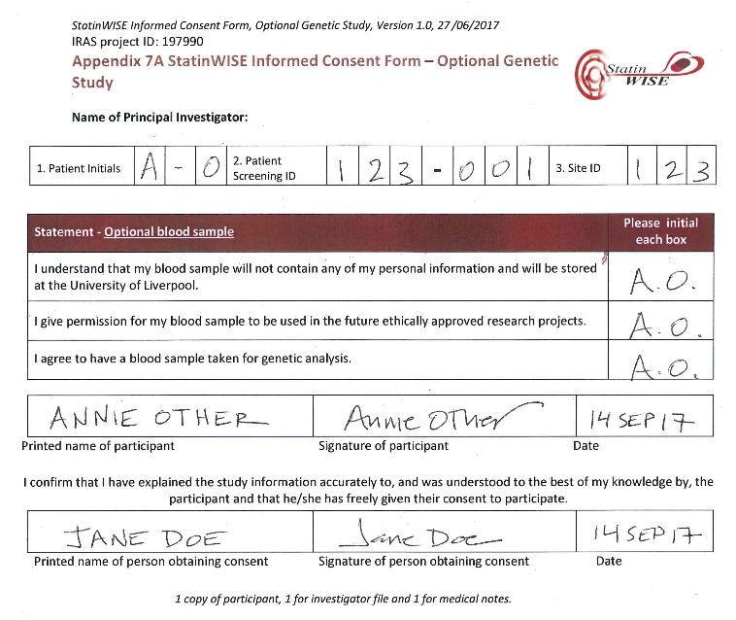
How to document consent for the genetic study?
If a patient wishes to also participate in the optional genetic study they will complete the Optional Genetic Study informed consent form like so:

Slide 7
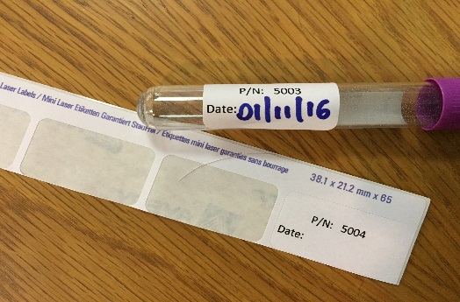
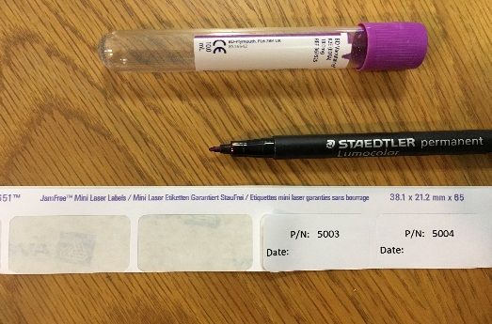
Taking the blood sample
Use an EDTA VACUTAINER tube provided with the Investigator Study File
9ml of blood should be taken as per local procedure
The genetic study ID is already printed on a label on each tube
Write the collection date on the label
Write “Statinwise” on the label
Note down the 4-digit number shown on the label as it is required on the Baseline form

Slide 8
Completing the Baseline form
Add the date onto the label
Add the tube number to Baseline form field 27b: this is the only number to track the blood sample

Slide 9
Posting the Blood Sample
The blood sample must be posted to University of Liverpool using the Safebox provided
→ Safebox instructions follow on next slide
Safebox must be posted on the same day through Royal Mail
Samples can only be collected, and posted, Monday to Thursday
  This is to ensure samples are not held
  in the posting system over weekends

Slide 10
Safebox – Step by Step (1/3)

Slide 11
Safebox – Step by Step 2/3

Slide 12
Safebox – Step by Step 3/3

Slide 13
Remember!
The genetic study is optional for StatinWISE participants
If patients want to participate, complete fields 27, 27a and 27b of the Baseline Form
  → This is the only way the CTU can track the tube!
Blood samples can only be taken Monday to Thursday
The blood sample must be posted on the same day that it was taken
Each Safebox can hold 1 -4 tubes

Slide 14


CONTACT US
London School of Hygiene & Tropical Medicine
Room 180, Keppel Street, London WC1E 7HT
Tel +44(0)20 7299 4684
Fax +44(0)20 7299 4663
Email: statinwise@Lshtm.ac.uk

