Slide 1




REPORTING SERIOUS ADVERSE EVENTS AND COMPLETING THE REPORT FORM
Trial protocol code: ISRCTN30952488
Version 2, 21 Nov 2017

Slide 2
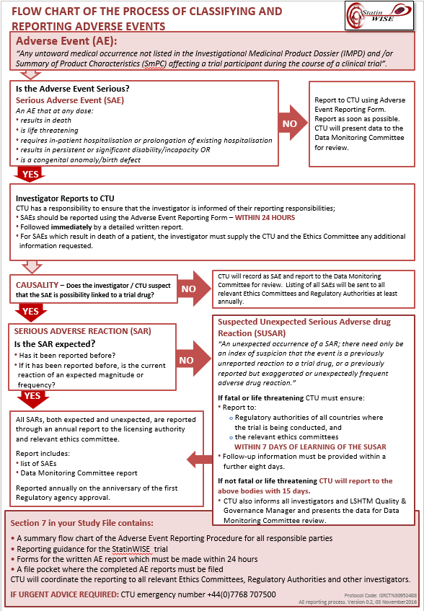
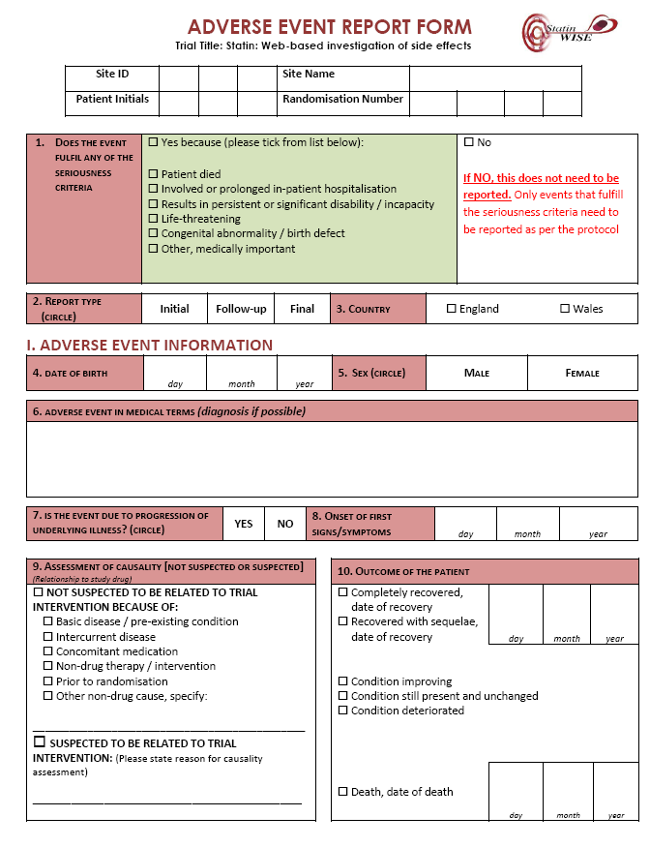
USE THIS PRESENTATION WITH:
The Trial Protocol (Section 2.9) and
Guidance for investigators: SERIOUS ADVERSE EVENT REPORTING AND COMPLETING THE REPORT FORM (Folder 1, Section 7 “Adverse Events” in ISF)

Slide 3
StatinWISE Definitions
Adverse Event (AE) for StatinWISE trial | Any untoward medical occurrence not listed in the Investigational Medicinal Product Dossier (IMPD) and/or SmPC for Atorvastatin 20 mg tablets affecting a trial participant during the course of the StatinWISE trial
Serious Adverse Event (SAE) | A serious adverse event is any untoward medical occurrence not listed in the in Investigational Medicinal Product Dossier (IMPD) and/or SmPC for Atorvastatin 20 mg tablets affecting a trial participant during the course of the StatinWISE trial that at any dose results in death; is life-threatening; requires in-patient hospitalisation or prolongation of existing hospitalisation; results in persistent or significant disability/incapacity; or is a congenital anomaly/birth defect.
Adverse Reaction (AR) | An adverse event when there is at least a possibility that it is causally linked to a trial drug or intervention
Serious Adverse Reaction (SAR) | SAE that is thought to be causally linked to a trial drug or intervention
Suspected Unexpected Serious Adverse Reaction (SUSAR) | An unexpected occurrence of a SAR; there need only be an index of suspicion that the event is a previously unreported reaction to a trial drug or a previously reported but exaggerated or unexpectedly frequent adverse drug reaction.

Slide 4
What should be reported in the StatinWISE trial?
Serious Adverse Events (SAE) are reported in the STATINWISE trial
A serious adverse event is any untoward medical occurrence not listed in the in Investigational Medicinal Product Dossier (IMPD) and/or SmPC for Atorvastatin 20 mg tablets affecting a trial participant during the course of the StatinWISE trial that at any dose
  results in death;
  is life-threatening;
  requires in-patient hospitalisation or prolongation of existing hospitalisation;
  results in persistent or significant disability/incapacity; or
  is a congenital anomaly/birth defect.

Slide 5
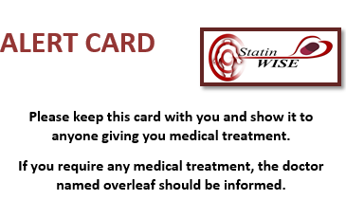
When should SAEs be reported?
Events are reportable from the point of Randomisation
SAEs must be reported within 24 hours when the site becomes aware of them
PI must verify all SAEs

Slide 6
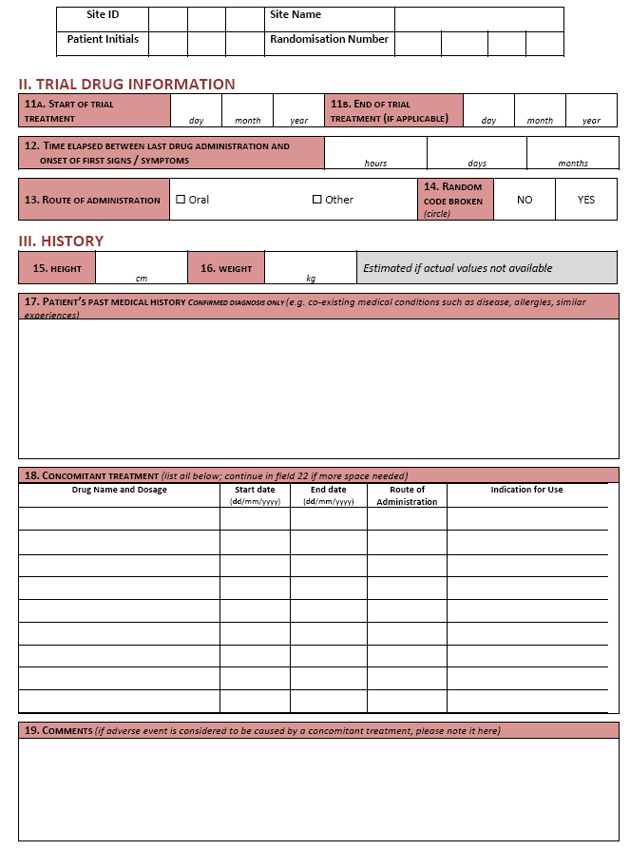
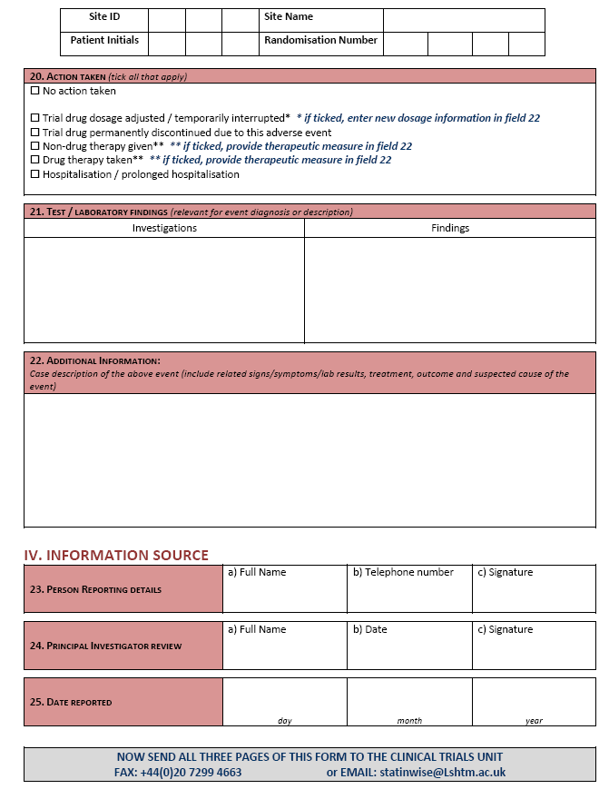
How are SAEs reported?
Complete the form online on the database OR
Complete the form provided in Section 7 of the Investigator Site File

Slide 7
Reporting Serious Adverse Events
All fields must be completed – do not leave blank fields. If the information is not known at the time of completing the form, write NK (not known) or NA (not applicable).
The information supplied on the form must be consistent with the data recorded in the source data i.e. medical records and other data forms.
The Initial form should be submitted even if there is only limited information. When any additional or relevant information becomes available, it should be submitted on follow-up report forms – there may be more than one follow-up form. If the event is serious, then follow-up data must be sent to the CTU within 24 hours.
In the follow-up report form, you must complete the header information (to identify the patient), the diagnosis must be completed (to identify the event) and only new or corrected information must be reported. Please note that the information provided in the follow-up report form supersedes the information previously reported.
The Initial report form should be submitted even if there is only limited information. When any additional or relevant information becomes available, it should be submitted to the CTU. If the form was initially submitted via the database, the form can be updated online. If the form was submitted on paper, additional forms can be submitted as follow-ups.

Slide 8
Reporting Adverse Events
When updating the online form or submitting a follow-up report, the diagnosis (question 6) must be entered (to identify the event) and only new or corrected information must be reported. If using paper forms, you must also complete the header information (to identify the patient). Please note that the information provided in follow-up reports supersedes the information previously reported.
SAEs that occur throughout the trial will be reported by the CTU to required authorities.
Completed paper forms can be sent by FAX to +44(0)20 7299 4663 or attached to an email and sent to statinwise@Lshtm.ac.uk
All fields must be completed – do not leave blank fields. If the information is not known at the time of completing the form, write NK (not known) or NA (not applicable).
The information supplied on the form must be consistent with the data recorded in the source data i.e. medical records and other data forms.

Slide 9
Reporting Adverse Events
In the follow-up report form, you must complete the header information (to identify the patient), the diagnosis must be completed (to identify the event) and only new or corrected information must be reported. Please note that the information provided in the follow-up report form supersedes the information previously reported.
Completed forms can be sent by FAX to +44(0)20 7299 4663 or as a scanned image/s attached to an email to statinwise@Lshtm.ac.uk
IF YOU NEED URGENT ADVICE ABOUT REPORTING AN ADVERSE EVENT PLEASE CALL: +44 207 299 4684 (Mon-Fri, 9am-5pm)
OR +44(0)7768 707500 (outside of office hours)

Slide 10
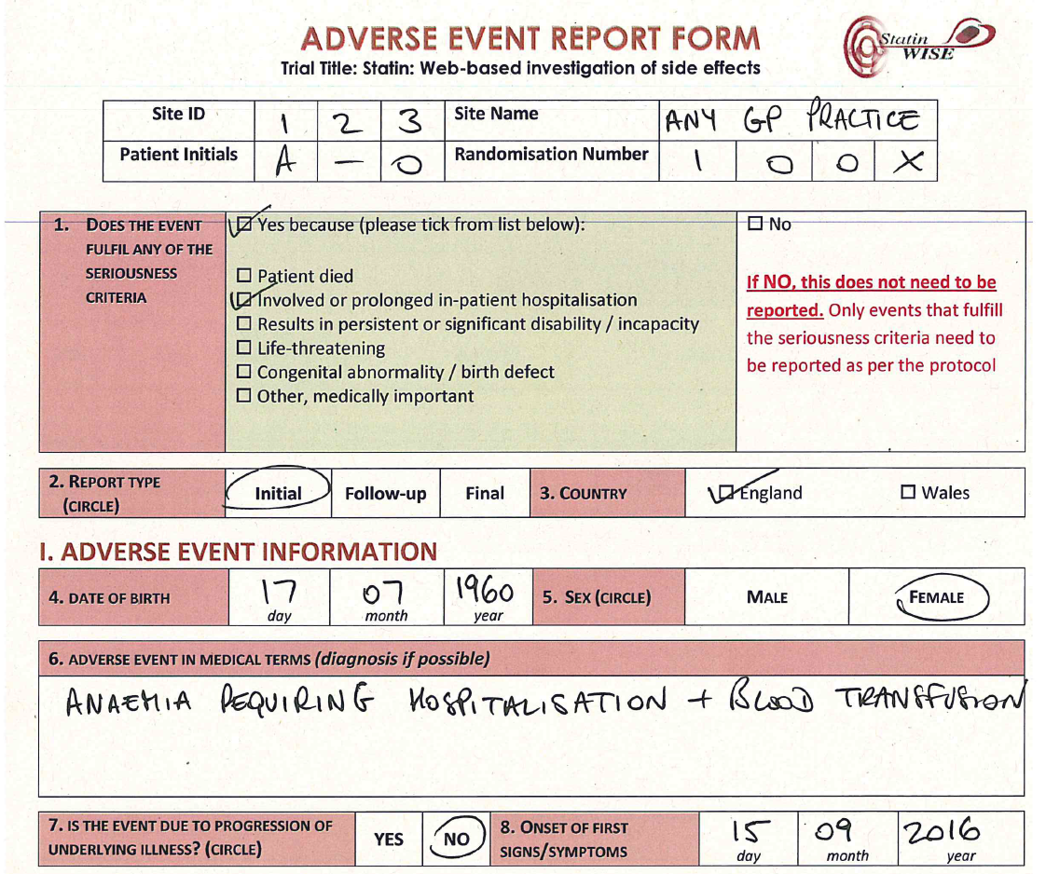

How to complete the
Adverse Events reporting form

Slide 11
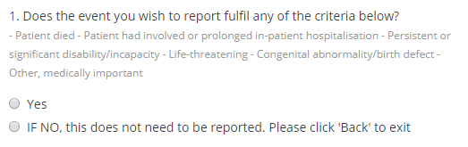
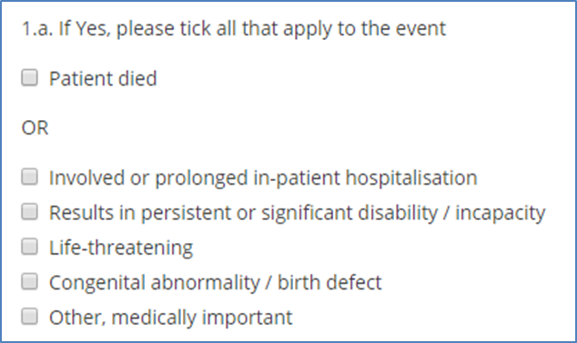
Using the Database
1. Select the appropriate boxes indicating if the event is an SAE and which criteria are fulfilled.

Slide 12
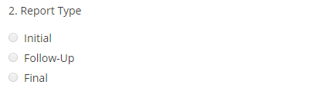



Using the Database
2. Select “INITIAL” if this is the first time the SAE is being reported
Select “FOLLOW-UP” for any subsequent information about the event.
Select “FINAL” if this is the last report concerning this event.
3. Select the name of the country where
the site is located
4. Enter the patient’s date of birth.
5. Indicate as appropriate

Slide 13
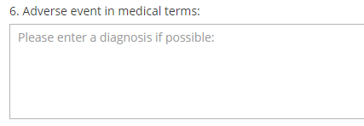


Using the Database
6. Enter the diagnosis if possible, otherwise the signs / symptoms relating to the event.
7. Indicate if this event is due to the progression of underlying illness.
8. Please insert the date when the first signs of the event were noted.

Slide 14
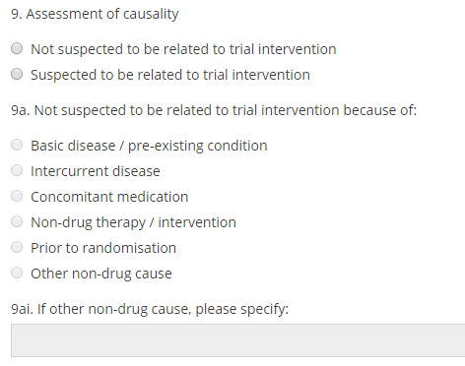
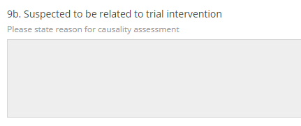
Using the Database
9. Indicate whether or not you suspect the event is related to atorvastatin or placebo.
NOT SUSPECTED: this is when a causal relationship between the event and administration of the trial drug is considered unlikely.
SUSPECTED: the temporal relationship of the event to trial drug administration makes a causal relationship possible.

Slide 15
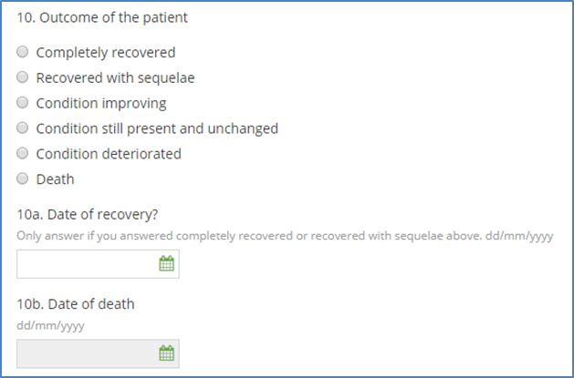
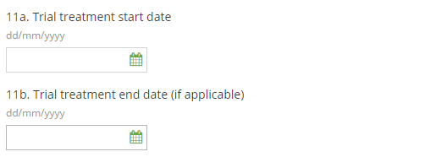
Using the Database
10. Complete as appropriate.
If the patient made a complete recovery or recovered with sequelae, enter the recovery date.
If the patient died, enter the date of death.
11a. Insert the date the trial treatment started (if known)
11b. Enter when the trial treatment ended

Slide 16
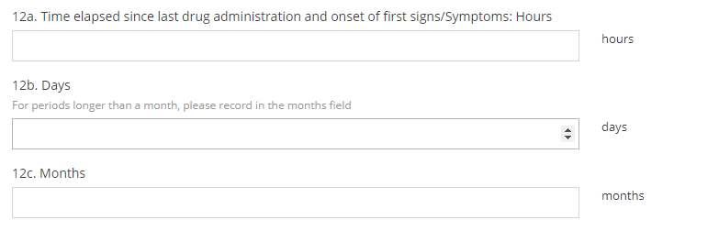
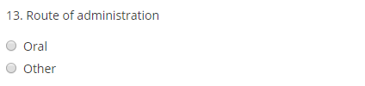



Using the Database
12. Enter the time between LAST trial drug administration and ONSET of
first signs / symptoms
13. Select the appropriate route of
administration of the trial treatment
14. Refer to protocol page 17 Unblinding
15. Enter the patient’s height in centimetres.
16. Enter the patient’s weight in kilograms.

Slide 17
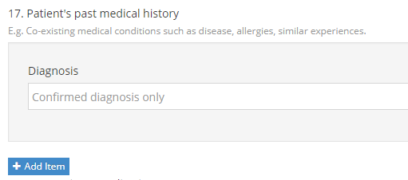
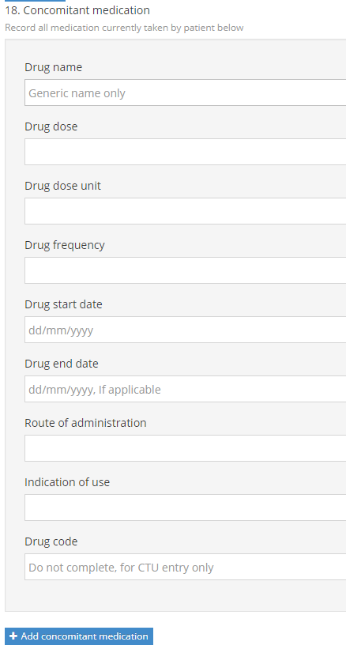
Using the Database
17. List here any medical conditions, allergies or similar experiences from the patient’s past history.
18. List all concomitant medications, their start and end dates and the indication for use (if using paper and there is not enough space, use a separate sheet).

Slide 18
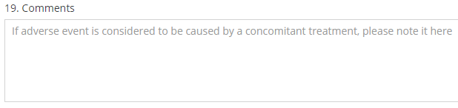
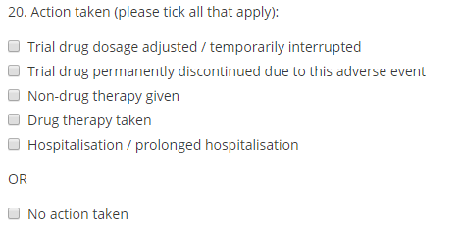
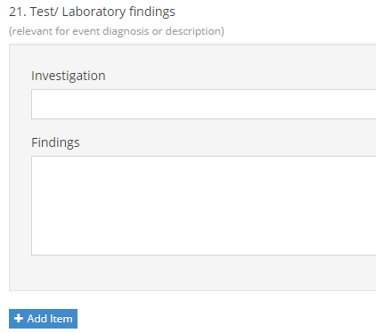
Using the Database
19. Add any comments in this section. Note here if the SAE is considered to be caused by any concomitant medication and state which medication is suspected.
20. Please select ALL that apply. Details of adjusted dosages and therapies given can be stated in field 22.
21. List all test/laboratory findings relevant to the diagnosis.

Slide 19
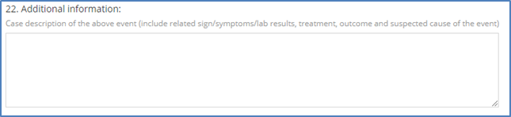
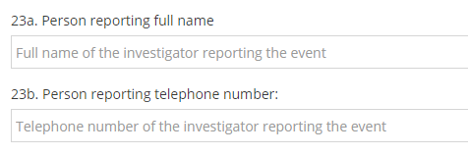
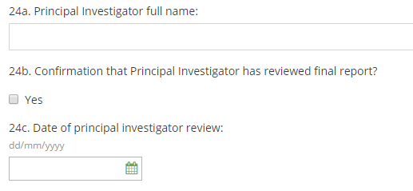

Using the Database
22. Fully describe the nature, severity, cause and any other information that helps understanding of the SAE. Describe the therapeutic measures taken and, if available, outcome details.
23. Please state full name and provide a direct telephone number at which you may be directly contacted.
24. The Principal Investigator review the final report
25. Please enter the date this form was completed.

Slide 20
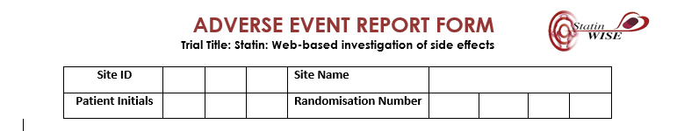
If Using Paper Form:
The form is 3 pages-long
All fields MUST be completed in the header on EACH page
All 3 pages MUST be completed
ALL fields must be completed in legible writing and in ball pen ink.

Slide 21
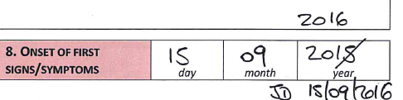
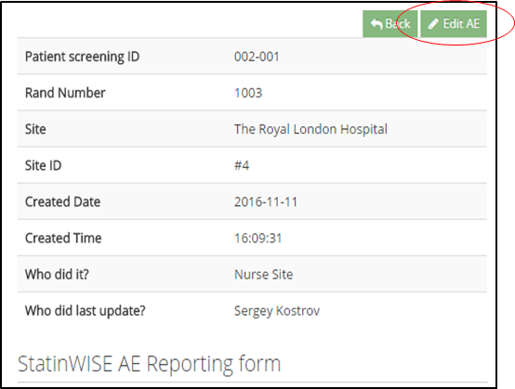
How to make corrections on the AE report form
HOW TO MAKE CORRECTIONS
On paper:
If you enter an incorrect value on the paper form:
Draw a single line through the incorrect value so it is still visible
enter the correct value alongside the value location
date and initial each change
Online:
a) Select the patient on the database and view the AE form
b) Select ‘edit AE’ option
c) Make the required changes
d) Complete the ‘reason for edit’ field and enter your unique pin (used for log in) before pressing ‘Submit’

Slide 22

How to submit the paper
reporting form
The form must be
Faxed to +44(0)20 7299 4663
or emailed to statinwise@Lshtm.ac.uk
Please store any original paper forms in
Section 15 of the Investigator Site File

Slide 23
Reporting Serious Adverse Events
For serious adverse events that fulfil ANY of the seriousness criteria, all 3 pages of the form must be completed and sent to the CTU WITHIN 24 HOURS of you becoming aware of the event.
If in doubt: Please report or call
us for advice

Slide 24


CONTACT US
London School of Hygiene & Tropical Medicine
Room 180, Keppel Street, London WC1E 7HT
Tel +44(0)20 7299 4684
Fax +44(0)20 7299 4663
Email: statinwise@Lshtm.ac.uk

