Slide 1




HOW TO ENTER END OF TRIAL DATA
Trial protocol code: ISRCTN30952488
Version 2, 21 Nov 2017

Slide 2
  What happens at the end of Treatment Period 6?
Site trial staff to contact patient to:
Thank them for their participation
Confirm this is the last week of treatment
Inform them that they will receive their individual results at the start of month 14
During 7th week of treatment period 6
Site trial staff to arrange appointment with patient to discuss their individual trial results
If patient wants to continue taking statins without break, patient must arrange to see GP before the end of treatment period 6
Start of month 14

Slide 3
Site trial staff will contact patient to:
document if they have received a statin prescription for after the study is completed
ask whether the trial helped with this decision
At month 15
Site trial staff to complete End of Trial form on the trial database

Slide 4
End of Trial for a patient
At month 15 an end of trial form must be completed
Section A to be completed
Direct database entry
Must be verifiable from medical records

Slide 5
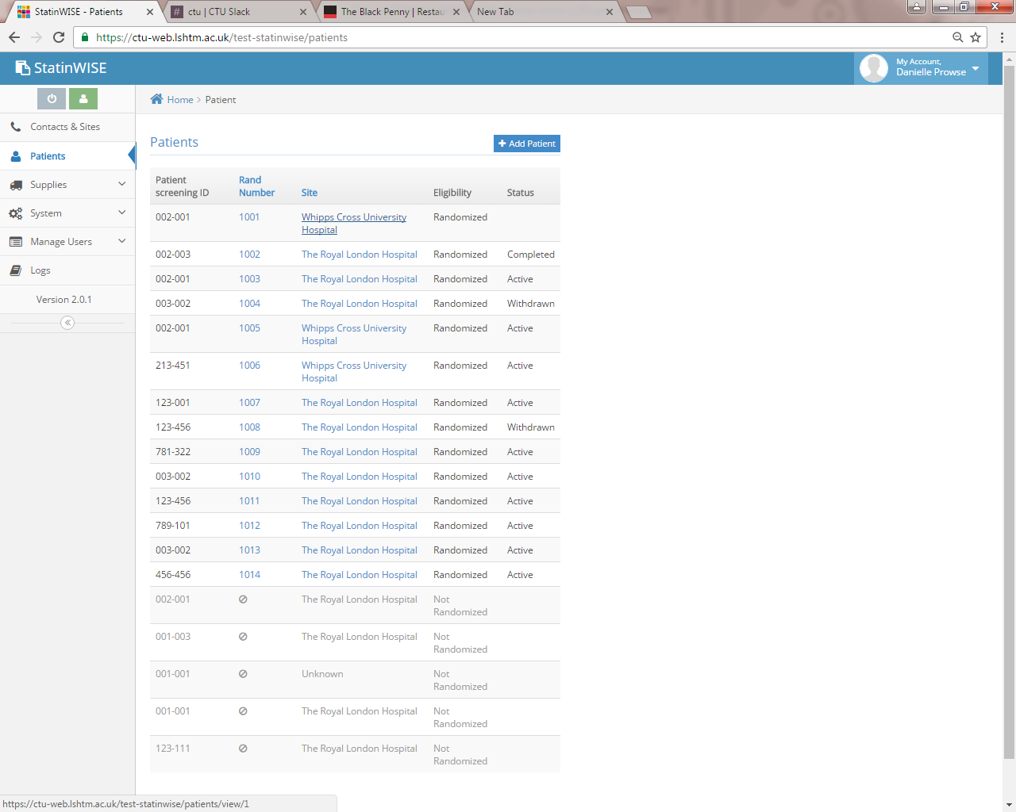
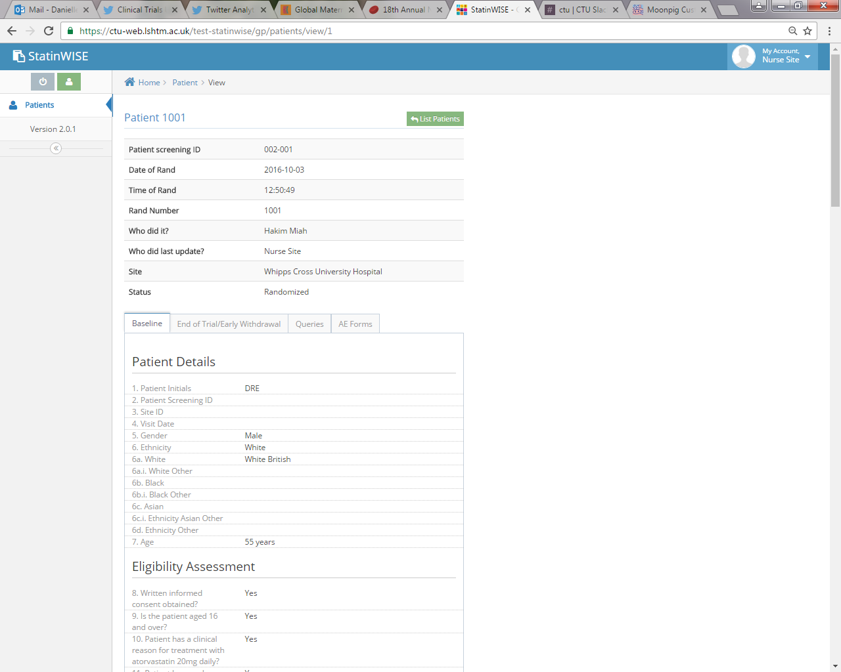
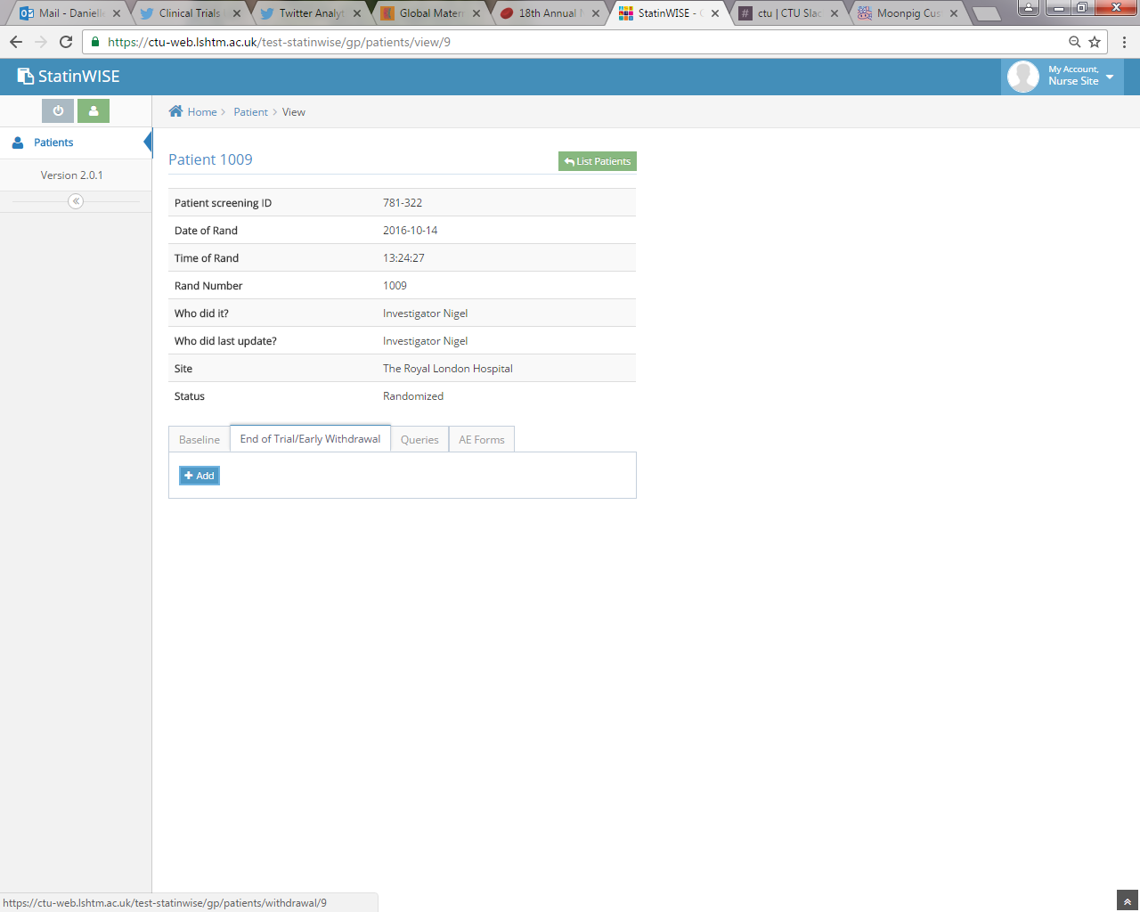
How to complete the end of trial form?
Select the patient who has completed the study
Select the end of trial/early withdrawal tab then add
User to log into database
Complete the form and submit

Slide 6
How to complete the end of trial form?
An appointment with the patient to discuss their individual trial results, should take place during Month 14
If appointment has taken place please provide the date on the form
If not, please arrange an appointment as soon as possible or enter the arranged appointment date
If patient has been prescribed a statin in the 12 weeks since treatment period 6 ended, please provide the generic statin name and daily prescribed dose in mg
In the last question, please enter the patient’s response to whether they have found the their own trial results helpful to reach the decision as to whether to continue statin use?
If no statin prescription has been made, ask the patient and document about their intent to continue long term statin therapy

Slide 7
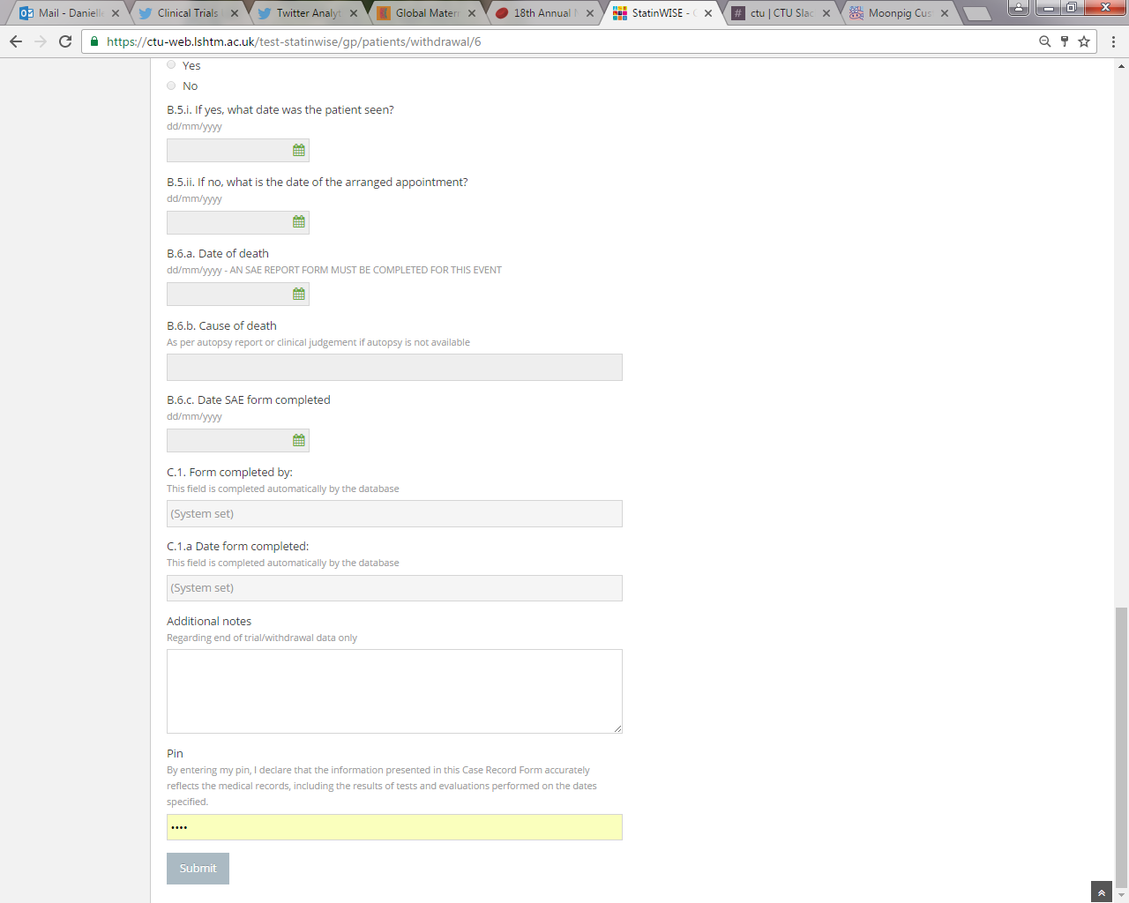
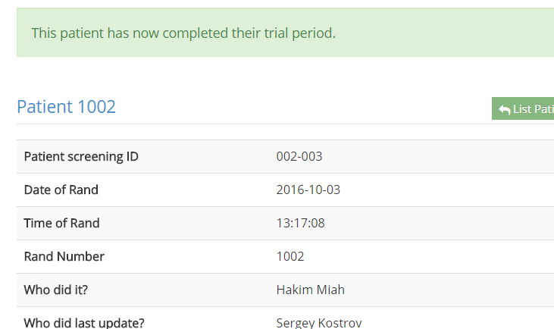

Submission of the end of trial form
Use the notes section to add any additional comments
To submit: trial site staff must enter personal pin to confirm data entered is accurate in line with medical records
The status of the patient changes to ‘completed’
After submission, data can be viewed but not edited. If data needs to be entered, contact the CTU with the required amendment

Slide 8


CONTACT US
London School of Hygiene & Tropical Medicine
Room 180, Keppel Street, London WC1E 7HT
Tel +44(0)20 7299 4684
Fax +44(0)20 7299 4663
Email: statinwise@Lshtm.ac.uk

