Slide 1
A series of randomised controlled N-of 1 trials in patients who have discontinued or are considering discontinuing statin use due to muscle-related symptoms to assess if atorvastatin treatment causes more muscle symptoms than placebo
REPORTING ADVERSE EVENTS AND COMPLETING THE REPORT FORM
Trial protocol code: ISRCTN30952488
Version 1, 17 November 2016

Slide 2
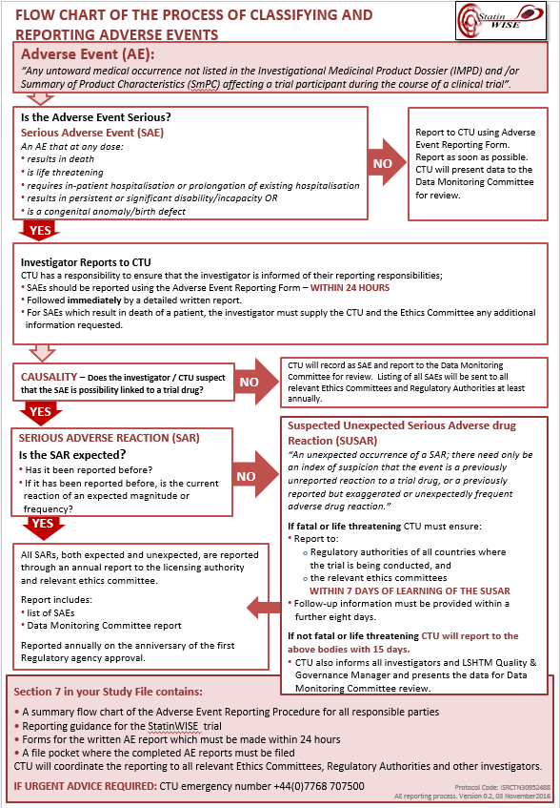
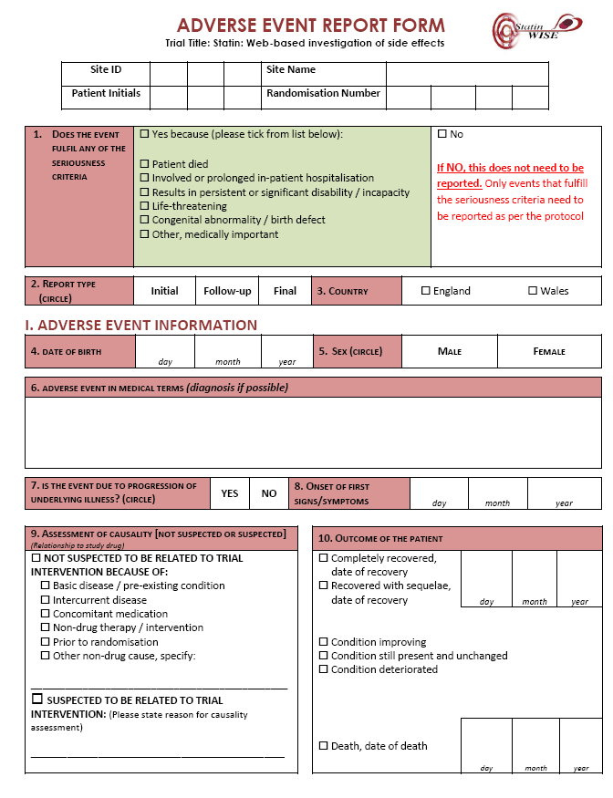
THIS PRESENTATION MUST BE USED WITH:
The Trial Protocol (Section 2.9) and
Guidance for investigators: ADVERSE EVENT REPORTING AND COMPLETING THE REPORT FORM (in Investigator Site File section 7)

Slide 3
Definitions
Adverse event (AE) | Any untoward medical occurrence affecting a trial participant during the course of a clinical trial
Serious Adverse Event (SAE) | A serious adverse event (experience) is any untoward medical occurrence that at any dose results in death; is life-threatening; requires in-patient hospitalisation or prolongation of existing hospitalisation; results in persistent or significant disability/incapacity; or is a congenital anomaly/birth defect.
Adverse Reaction (AR) | An adverse event when there is at least a possibility that it is causally linked to a trial drug or intervention
Serious Adverse Reaction (SAR) | SAE that is thought to be causally linked to a trial drug or intervention
Suspected Unexpected Serious Adverse Reaction (SUSAR) | An unexpected occurrence of a SAR; there need only be an index of suspicion that the event is a previously unreported reaction to a trial drug or a previously reported but exaggerated or unexpectedly frequent adverse drug reaction.

Slide 4
What should be reported as AE or SAE in the StatinWISE trial?
Adverse Event (AE)
Any untoward medical occurrence not listed in the Atorvastatin 20mg SmPC (appendix 8 of protocol) affecting the trial participant during the course if a clinical trial
Serious Adverse Event (SAE) is an AE which at any dose:
Results in death
Is life-threatening
Requires inpatient hospitalisation or prolongation of existing hospitalisation; or
Results in persistent or significant disability/incapacity
Is a congenital anomaly/birth defect

Slide 5
When should AE or SAE be reported?
Events are reportable from the point of Randomisation as this is when the Patient Alert card will be given to them
Events should be reported within 24 hrs of becoming aware

Slide 6
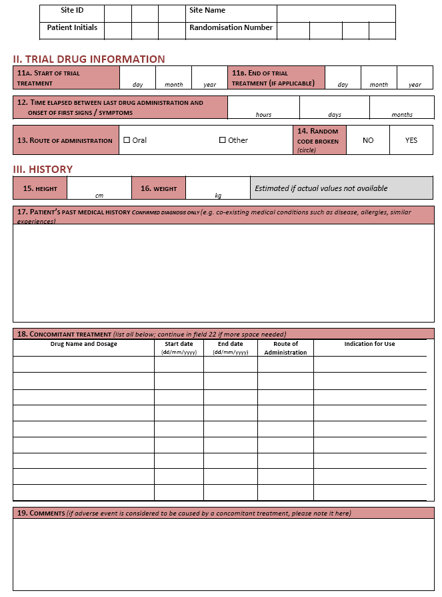
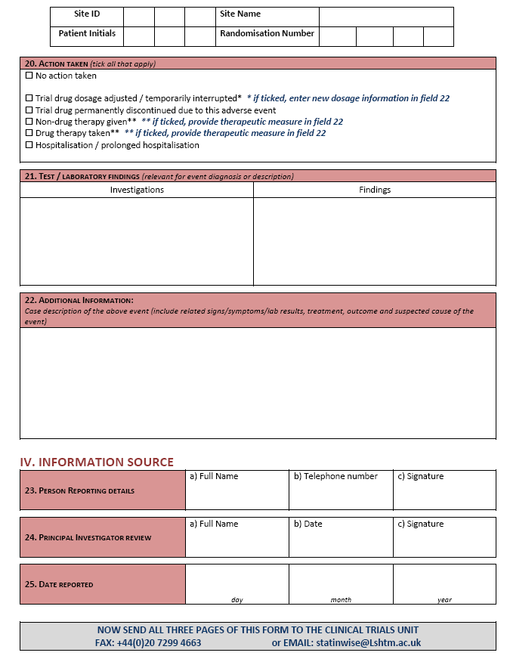
How should AE and SAE be reported?
Complete the paper AE form provided in Section 7 of the Investigator Site File OR
Complete the form online on the database

Slide 7
Reporting Adverse Events
The Adverse Event Report form must be completed by hand and in English. Please ensure that you write clearly
For adverse events that fulfil ANY of the seriousness criteria, all 3 pages of the form must be completed and sent to the CTU WITHIN 24 HOURS of you becoming aware of the event.
If in doubt: Please report or call
us for advice

Slide 8
Reporting Adverse Events
All fields must be completed – do not leave blank fields. If the information is not known at the time of completing the form, write NK (not known) or NA (not applicable).
The information supplied on the AE form must be consistent with the data recorded in the source data i.e. medical records and other data forms.
The Initial adverse event report form should be submitted even if there is only limited information. When any additional or relevant information becomes available, it should be submitted on follow-up report forms – there may be more than one follow-up form. If the event is serious, then follow-up data must be sent to the CTU within 24 hours.
In the follow-up report form, you must complete the header information (to identify the patient), the diagnosis must be completed (to identify the event) and only new or corrected information must be reported. Please note that the information provided in the follow-up AE report form supersedes the information previously reported.
Completed forms can be sent by FAX to +44(0)20 7299 4663 or as a scanned image/s attached to an email to statinwise@Lshtm.ac.uk.
IF YOU NEED URGENT ADVICE ABOUT REPORTING AN ADVERSE EVENT PLEASE CALL: +44 207 299 4684 (Mon-Fri, 9am-5pm)
OR +44(0)7768 707500 (outside of office hours)

Slide 9
Reporting Adverse Events using the paper form
The Adverse Event report form can be used to report all adverse events in line with the Protocol
Adverse Event report forms can be found in your Investigator Site File Section 7 and on the CD inside the front cover

Slide 10
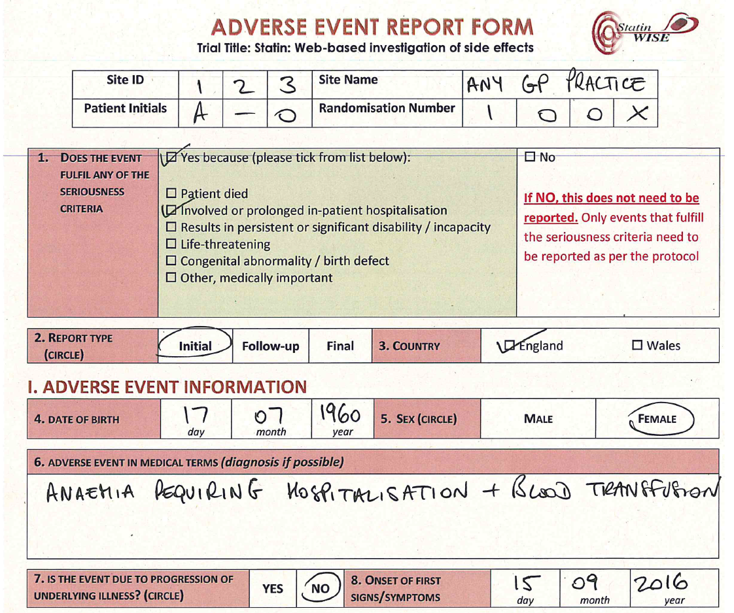
How to complete the
Adverse Events reporting form

Slide 11
Header and Section 1
The AE form is 3 pages-long
All fields MUST be completed in the header on EACH page
All 3 pages MUST be completed
Atorvastatin has a well-documented safety profile and on the basis that:
Participants would have had prior exposure the trial treatment,
the trial treatment is clinically indicated for their medical condition, and
the known safety profile of the trial treatment,
We will limit adverse events to be reported to those events that fulfill the Serious Adverse Event (SAE) criteria as described in the green box below:

Slide 12
Sections 2 to 8
Circle INITIAL if this is the first data being submitted for this SAE
Circle FOLLOW-UP for any subsequent information
Circle FINAL if this is the final data being submitted for this SAE
Tick the COUNTRY where the event occurred. This is most likely to be the country you are located in.
Enter the participant’s date of birth
Circle either male OR female
Enter the diagnosis if known, otherwise the sign(s) / symptom(s) relating to the event
Please indicate if this event is due to GI bleeding or any other pre-existing illness
Insert the date when the first signs of the event were noted

Slide 13
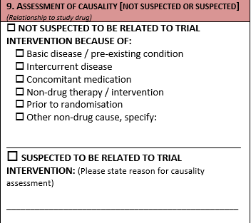
Section 9
Please indicate whether or not you suspect the event is related to tranexamic acid or placebo
If you suspect the event is related to the trial intervention you must enter a reason for causality
NOT SUSPECTED: This is when a causal relationship between the event and administration of the trial treatment is considered unlikely. This may be because other drugs, therapeutic interventions or underlying conditions provide a sufficient explanation for the observed event.
SUSPECTED: The temporal relationship of the event to trial treatment administration makes a causal relationship possible – and other drugs, therapeutic interventions or underlying conditions do not provide a sufficient explanation for the observed event.

Slide 14
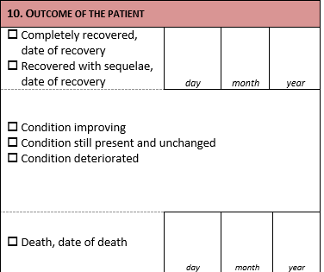
Section 10
Tick as appropriate
If the participant made a complete recovery/recovered with sequelae please enter the date of recovery (DD MM YYYY), otherwise do not enter a date
If the participant died, please enter the date of death (DD MM YYYY)

Slide 15
Sections 11 to 14
Insert the date (DD MM YYYY) when the trial treatment started
Insert the date (DD MM YYYY) when the trial treatment ended if applicable
Enter the time between last administration of the trial treatment and onset of the first signs or symptoms
Tick the route of administration of the trial treatment
Circle as appropriate refer to the Protocol page 17 UNBLINDING

Slide 16
Sections 15 to 17
If the exact height and weight are not known, please enter an estimate
Note: The exact height and weight may become available later and the estimates can be overwritten
List here any other medical conditions, allergies or similar experiences in the patient’s past medical history

Slide 17
Sections 18 to 19
List all concomitant drugs/medications If you need more space use a separate sheet
Make a note here if the SAE is considered to be caused by any concomitant medication and state which medication is suspected

Slide 18
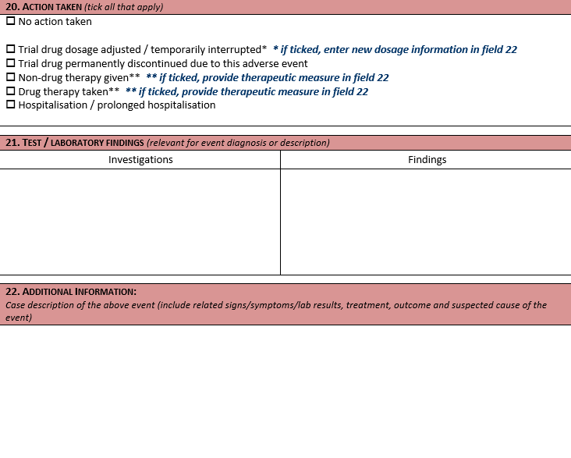
Sections 20 to 22
Please tick ALL that apply. Details about adjusted dosage and drug and non-drug therapies can be noted in field 22
List all tests/laboratory findings relevant to the diagnosis of the SAE
In this section fully describe the nature, severity, cause and any other information that helps an understanding of the SAE. Describe therapeutic measures taken and, if available, outcome details. Please use precise medical terminology.

Slide 19
Sections 23 to 25
The staff completing the form should write their full name and provide a direct telephone number where s/he may be contacted urgently
Remember to sign the form
The PI must be informed of the SAE and sign field 24 to confirm s/he has reviewed the form
Enter the date of this form is completed in format DD MM YYYY

Slide 20
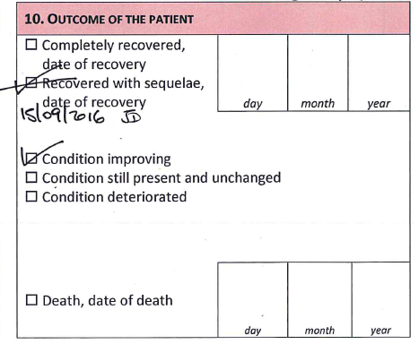
How to make corrections on the AE report form
If you enter an incorrect value on the form:
Cross out the incorrect value so it is still visible
Enter the correct value alongside
Enter the date and your initials alongside each change
EXAMPLES

Slide 21
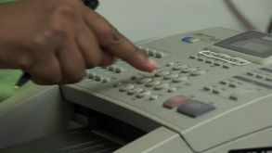
How to send the Adverse Events
reporting form
The form must be
Faxed to +44(0)20 7299 4663
or emailed to statinwise@Lshtm.ac.uk
Please store any original paper forms in
Section 15 of the Investigator Site File

Slide 22
CONTACT US
London School of Hygiene & Tropical Medicine
Room 180, Keppel Street, London WC1E 7HT
Tel +44(0)20 7299 4684
Fax +44(0)20 7299 4663
Email: statinwise@Lshtm.ac.uk

