Slide 1
A series of randomised controlled N-of 1 trials in patients who have discontinued or are considering discontinuing statin use due to muscle-related symptoms to assess if atorvastatin treatment causes more muscle symptoms than placebo
HOW TO TRAIN PATIENTS ON COMPLETING THE QUESTIONNAIRES
Trial protocol code: ISRCTN30952488
Version 1, 17 November 2016

Slide 2
What is required of patients
At the end of each 2 month trial treatment period, patients are required to complete:
7 x VAS pain scale questionnaires; one every day during week 8 of each treatment period
The end of treatment period patient questionnaire on Day 56
This will be repeated during week 8 of each treatment period for the duration of the trial

Slide 3
The 4 methods of data collection
At the baseline visit, each patient will chose which is their preferred method of data collection. The following options are available:
1. Using the online StatinWISE database
2. Via telephone calls with the CTU staff
3. Via the StatinWISE mobile app
4. Completing paper forms and posting to the CTU
The baseline visit should be used to familiarise the patient with their chosen method and train them where necessary
Note – if a patient changes their mind on the chosen method throughout the course of the trial, this can be changed by contacting CTU staff

Slide 4
Method 1: Online StatinWISE database
Patients will not have a database account and log in details
When data is due, patients will receive an email with a unique link that will direct them to their required form ready for entry
The database will provide clear guidance for the patient to follow
Once submitted, the data form will be marked as completed and the patient will not be able to view this
Advantages of using the database
Automatic database checks identify any missing fields before form can be saved
Illogical data cannot be entered into the database minimising queries and data that can’t be used
Accessible on computer, tablet or phone
Fast, secure receipt at the CTU
Disadvantages of using the database
Requires patient to have internet access and feel comfortable using the internet
Overdue and due data
Completed data

Slide 5
Training patients to use the trial database
CTU will provide web training files that mimic the live database
During the baseline visit the GP/RN, with the patient, should:
Access practise files online
Practise entering and submitting the end of treatment period questionnaire or the VAS pain report

Slide 6
Method 2: Over the phone with the CTU staff
A daily telephone call between the patient and CTU staff during week 8 of each treatment period to collect the data that is due over the phone
CTU staff to transcribe all answers and enter this data into the database
Advantages of using telephone calls
Technology free for patients who are not comfortable with using the internet
CTU staff will ensure all required answers have been given and nothing is missing
Disadvantages of using telephone calls
Less flexibility on time of day this can be done – must be in working hours
Requires availability of an appropriate CTU staff member

Slide 7
Method 3: StatinWISE mobile app
This is currently still in development and not available yet for use
Download and demonstration given to patient at baseline visit
The bespoke, free app will use push (in-built) notifications to inform the patient when data is due
The notifications will direct the patient to the required form to be completed
Advantages of using the mobile app
Able to use and upload data on the go
Automatic checks identify any missing fields before data can be saved
Illogical data cannot be entered into the app minimising queries and data that can’t be used
Fast, secure receipt at the CTU directly into the trial database
Reminders to your mobile
Disadvantages of using the mobile app
Requires patient to have a smartphone and feel comfortable in using mobile apps

Slide 8
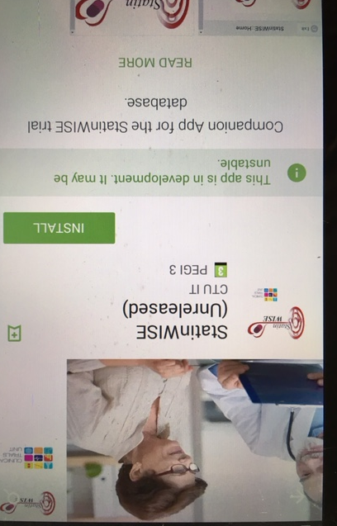
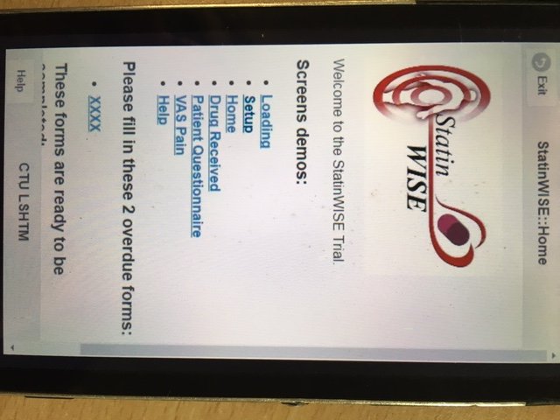
Training patients on using the mobile app
We will inform you when the App is available for patients to use
On the App Store, search ‘StatinWISE’
Internet access to be provided by GP practice so patient does not use their own mobile data to download
A training app is being developed for patients to practice entry and submission at baseline visit

Slide 9
Method 4: Completing paper data forms
Patients will receive paper versions of the data collection forms in the post at the same time as their trial treatment
Patients should complete the questionnaires with blue/black biro pen
CTU staff can telephone patients to remind them to complete the forms if they wish
After Day 56, patient is to send completed forms to the CTU in the post with their trial treatment pack from that treatment period – prepaid envelopes are supplied
Advantages of using paper data forms
Technology free for patients who are not comfortable with using the internet
Disadvantages of using paper data forms
Risk of patients completing data forms retrospectively
Delay to the receipt of data at CTU
No checks for missing data fields or illogical fields – risk of data received being unusable
Paper data forms must be stored at the CTU

Slide 10
Training patients on using paper data forms
At baseline, GP/Research nurse is to go through the paper data forms with the patient
All guidance for completion is provided clearly in red and should be used to train the patient
Patients must follow each question guidance very carefully as some questions should only be answered based on previous responses

Slide 11
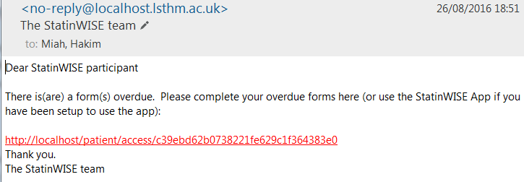
Submitting data on time
To ensure that patients submit their data when it is due, we will send reminders to patients:
In the seventh week of each treatment period, by their desired format, we will remind the patient that follow-up data collection is approaching
Patients can chose to receive a daily reminder on each day data is to be collected
Patients must complete all data by midnight on the day it’s due
If data becomes overdue, a reminder will be sent to patients. CTU staff may also attempt to telephone the patient
As the data collected should not be completed retrospectively, any data that is not submitted on time may not be used in the trial data set

Slide 12
General guidance for patients
Once submitted, patients cannot view or edit their entered data
If the patient has made a mistake on submitted / posted data, they should contact the StatinWISE CTU team
The CTU may have queries about patient data and will contact the patient directly to resolve them. Ensure at the baseline visit that the patient is aware of this
If a patient changes any of their contact details during the course of the trial, they must inform the CTU
If patients have any questions whilst trying to upload data, they are advised to contact the CTU on the Freephone 0800 number. This can be found on their treatment packs

Slide 13
CONTACT US
London School of Hygiene & Tropical Medicine
Room 180, Keppel Street, London WC1E 7HT
Tel +44(0)20 7299 4684
Fax +44(0)20 7299 4663
Email: statinwise@Lshtm.ac.uk

