Slide 1
A series of randomised controlled N-of 1 trials in patients who have discontinued or are considering discontinuing statin use due to muscle-related symptoms to assess if atorvastatin treatment causes more muscle symptoms than placebo
HOW TO ENTER BASELINE DATA
Trial protocol code: ISRCTN30952488
Version 1, 17 November 2016

Slide 2
Baseline Visit Overview
Patient attends the practice for the Baseline visit with Research Nurse
Research Nurse explains the trial and answers any questions
Full informed consent must be recorded on Informed Consent form provided in Site File
Patient changes their mind
Patient does not meet all eligibility criteria
Patient is not randomised
Complete the Screening log
Patient meets all eligibility criteria
Patient is randomised
Complete the Randomisation log

Slide 3
Entering baseline data
The Trial Database: https://ctu-web.lshtm.ac.uk/statinwise/
Enter your log-in details sent to you by the CTU
On the welcome page, click Patients on the left hand side and +Add patient
The patient baseline form appears and you can begin entering. Start with selecting your hospital from the drop down site box

Slide 4
The baseline data form
To be completed directly onto the database only – no paper copy is required
Consists of 6 main sections to complete:
Confidential details
Patient details
Eligibility assessment
Patient general medical history
Randomisation data
Training form
All ‘required’ fields must be completed → database will not allow blank fields apart from
cholesterol and QRISK2 score fields.
They may be left blank if cholesterol results are not yet available but must be provided as soon as possible

Slide 5
Section 1: Patients confidential details
These details are not part of the trial data set. They are only required for co-ordination of the trial.
Please double check that these details have been entered correctly
Includes:
Patients name
Postal address – required for sending trial drug to the patient in the post
Email addresses
Mobile and telephone number - required for contacting the patient throughout course of trial

Slide 6
Section 2: Patient details
Questions 1 – 7
This is the start of the data collected as part of the trial
Includes:
Patients initials (maximum 3 characters)
Ethnicity (select a main ethnic category and then a subcategory. Please specify if other is selected)
Age (patient must be over 16 to be eligible)

Slide 7
Section 3: Eligibility Assessment
Questions 8 – 15
Series of yes/no answers
For the patient to be considered eligible and randomised upon submission:
Questions 8 - 13 must be YES
(The database has an inbuilt, automatic eligibility check)

Slide 8
Eligibility Assessment
Eligibility criteria also depends on the patients documented levels of ALT and CK
The ALT and CK results must be provided
For the patient to be considered eligible and randomised upon submission:
Question 14 and 15 must be NO
(The database has an inbuilt, automatic eligibility check)

Slide 9
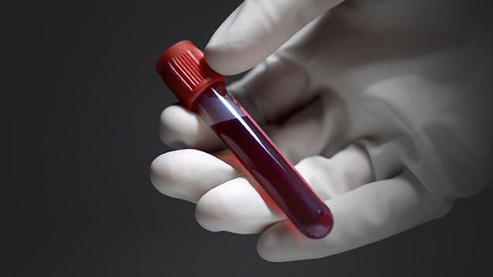
Patient general medical history
Questions 16 - 27
Includes:
A systolic and diastolic blood pressure measurement – to be measured at baseline visit
Height and weight information – to be measured at baseline visit
Patients total cholesterol measurement in mmol/L – must have been measured within the last 3 years
Any concomitant medication that the patient is on at the point of the baseline visit - to provide generic drug names only, daily dose and unit measurement
If a blood sample has been taken for the genetic study, please post this on the same day

Slide 10
Section 4: Randomisation
Questions 28 - 30
The database considers the answers provided in the eligibility assessment as to whether the patient is eligible or not
If the patient is eligible, once the baseline form is submitted, the database will proceed to randomise the patient
The randomisation number, date and time is automatically generated by the database upon submission
If upon submission, a pop up message that states the patient is not eligible but you believe that they are, please re-visit your answers to Q7 – Q15

Slide 11
Section 5: Training form
Questions 31 - 32
Records the method of data collection that the patient has chosen for their follow up period
Patients can chose their data collection method to be:
Online via the database
Using the mobile app on their smartphone
Via telephone conversations with the CTU staff
Using paper data forms - these are sent in the post with the treatment packs
Use the notes section to add any additional comments from the baseline visit

Slide 12
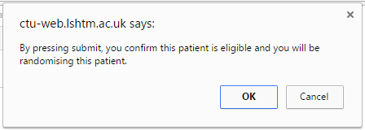
Submission of baseline data
Before submitting, check all fields have been completed correctly. Data will not save with any missing/illogical fields and user will be redirected to field and error text
To submit – investigators must enter their personal pin to confirm data entered is accurate in line with medical records
If patient is eligible, user will receive a pop up alert to confirm the patient’s randomisation

Slide 13
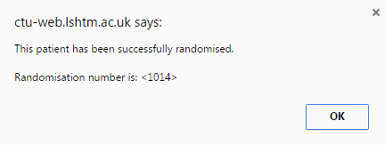
Submission of baseline data
Pressing OK will confirm patient is randomised and user will receive patients assigned randomisation number in pop up alert
By clicking OK to pop alert, patient overview can now be seen
Patient will receive a trial welcome email (check junk mail) and SMS simultaneously. GP/patient should alert the CTU if they have not received either

Slide 14
If you’ve made a mistake in data entry
You have made a mistake on patients eligibility criteria and you do not randomise a patient that is in fact eligible?
You must complete the baseline form again
You have made a simple typo on the entry?
Contact the Statinwise trial team and we will correct this for you
If you randomise a patient by mistake when they are in fact not eligible?
You must complete a protocol deviation form

Slide 15
CONTACT US
London School of Hygiene & Tropical Medicine
Room 180, Keppel Street, London WC1E 7HT
Tel +44(0)20 7299 4684
Fax +44(0)20 7299 4663
Email: statinwise@Lshtm.ac.uk

