Slide 1




A series of randomised controlled N-of 1 trials in patients who have discontinued or are considering discontinuing statin use due to muscle-related symptoms to assess if atorvastatin treatment causes more muscle symptoms than placebo
MAINTAINING THE INVESTIGATOR’S SITE FILE
Trial protocol code: ISRCTN30952488
Version 1, 17 November 2016

Slide 2
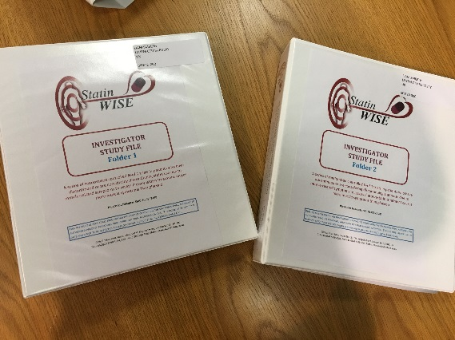

Your Investigator Site File (ISF)
Sent when all the necessary approvals / agreements are in place at your practice
Contains all the information you need to conduct the trial, including training materials
Ensures all study related documents are filed together
Documents will demonstrate your compliance with the protocol, GCP, regulatory requirements
Familiarise yourself with the contents of all sections, so you know where to find the information when needed
Please return the receipt inside the front cover

Slide 3
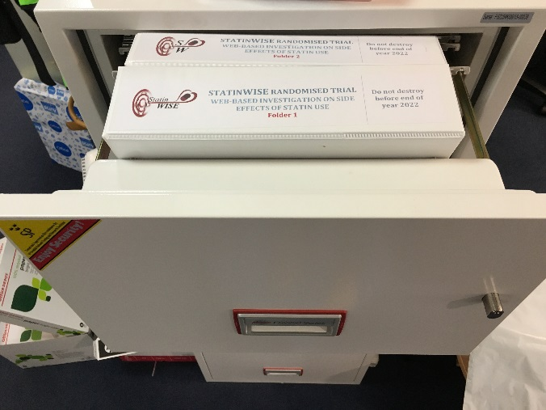
Investigator Site File
Keep in a secure location
To be accessible to the trial team
It is a legal requirement to keep the study file up to date
Must be available for monitoring visits by the CTU and any relevant regulatory authorities

Slide 4
Maintaining the ISF
Ensure all logs are up to date:
  Site responsibility delegation log
  Screening log
  Randomisation log
  Site visit log
Documents e.g. consent forms, data forms, reports, communication with the CTU etc to be filed regularly
Arrangements for archiving for five years after the end of the trial

Slide 5
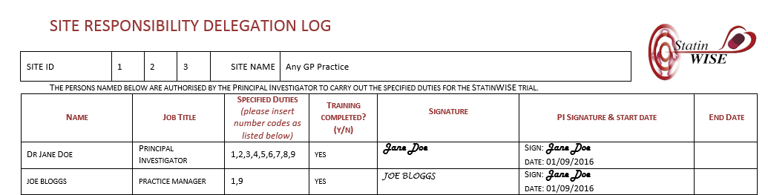
Site responsibility delegation log
This log is contained in section 17 Site responsibilities of the ISF
List all members of staff involved in the conduct of the trial e.g. doctors, nurses, practice managers, administrators
Add new staff members when they join the trial team
Note the end date for those who leave
When a team member leaves the trial, ensure they are replaced with a new team member and trained for their allocated tasks
A brief CV (signed and dated) for each person listed on the log, to be filed in section 17

Slide 6
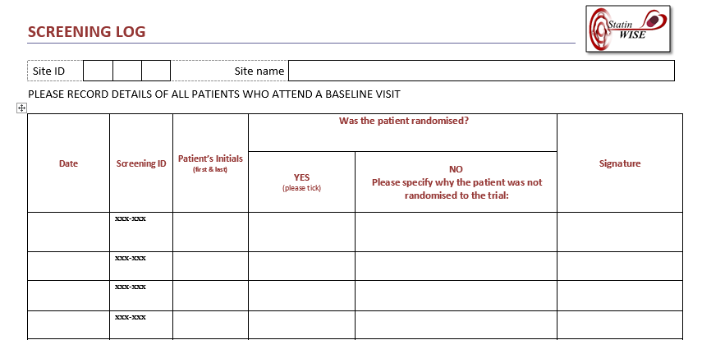
Patient screening log
This log is contained in section 14 Patient Entry of the ISF
Screening log keeps a record of patients who attended for a Baseline visit
This log is pre-populated with screening IDs for your site
If more screening logs are required, please contact the CTU

Slide 7
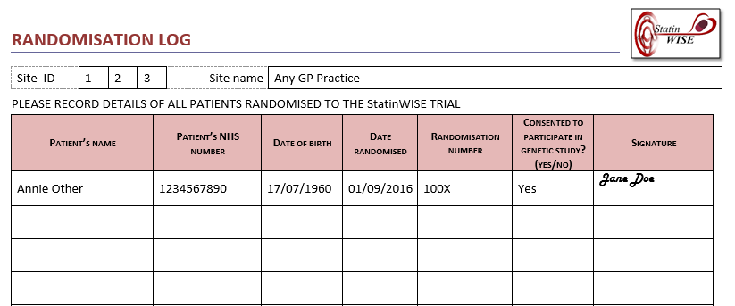
Randomisation log
This log is contained in section 14 Patient Entry of the ISF
Use to document patients randomised into the StatinWISE trial
Must be updated after each randomisation
A patient is considered randomised when the database generates the randomisation number
Randomisation number is the patients Study ID for the duration of the trial
Randomisation Number forms part of the Treatment Pack number

Slide 8
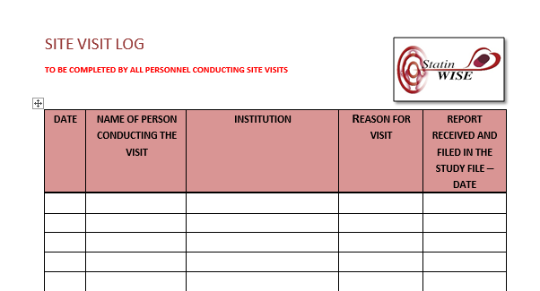
Site visit log
This log is contained in section 12 Trial Monitoring of the ISF
Update every time there is a trial related visit to your site i.e. CTU representative or regulatory body
The reason for the visit might be site training, planned monitoring visit, triggered monitoring visit, Sponsor or regulatory audit

Slide 9
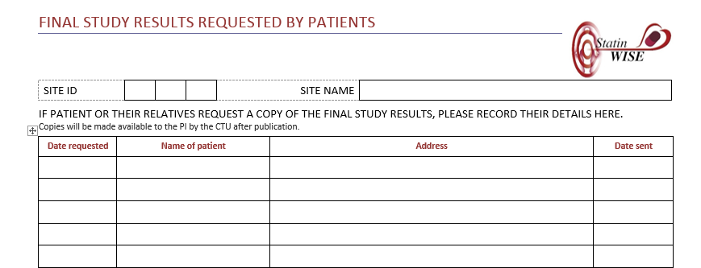
Final study results log
This log is contained in section 18 Reports
Ask the patients you have considered for participation if they or their relatives wish to receive a copy of the final trial full results
If so, record the contact details on this form
At the end of the trial the PI or CTU will post copies of the final report to the addresses entered

Slide 10
Documents to be filed routinely
Type of Document | Section in Study File where this document should be filed
Completed ADVERSE EVENT reporting forms | 15 Completed Forms
Correspondence with ethics committee | 8 Ethics
Correspondence with regulatory agency | 9 Regulatory
Visit and Monitoring reports | 12 Trial Monitoring
Original Signed CONSENT FORMS (for patient) | 15 Completed Forms
Data queries | 15 Completed Forms
Correspondence with CTU (emails, letters etc) | 16 Correspondence
CVs of trial team | 17 Site Responsibilities, Training logs & Certificates
GCP Training certificates of your trial team | 17 Site Responsibilities, Training logs & Certificates
These documents must be systematically filed when they become available
They will be required for monitoring purposes

Slide 11
Training materials
Additional training materials may be requested at any time
The ProtocoL
The copy for you and your team to use is inside the front cover
The copy in Section 2 is the version submitted for your ethics and regulatory approvals and must not be removed from the Study File
Contains the Summary of Product Characteristics (SmPC) for atorvastatin (the trial drug). The SmPC is the guidelines on the use of atorvastatin that have been approved by the UK regulatory agency
Manual of Operating Procedures (MOP)
Can be found in Section 3 Training Materials
Contains detailed guidance on all aspects of the practical conduct of the trial

Slide 12
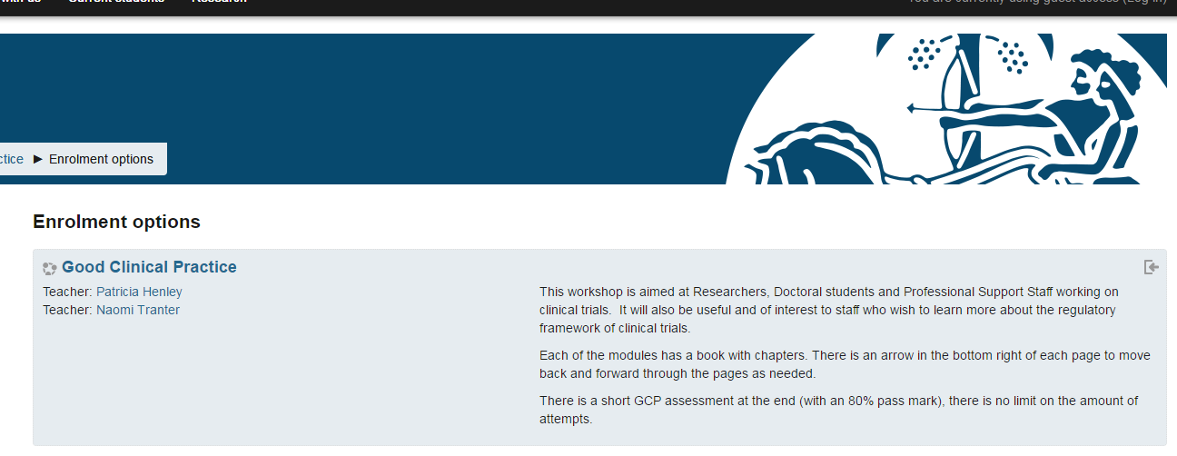
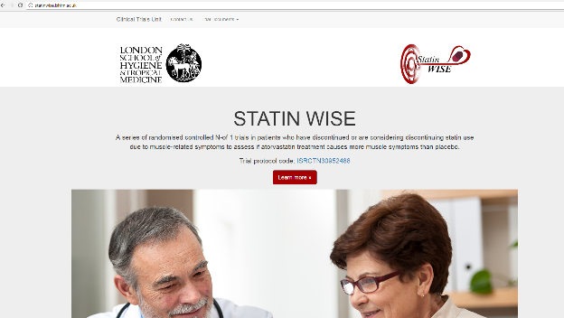
Training materials
INVESTIGATIONAL MEDICINAL PRODUCT DOSSIER (IMPD)
Contains all the information relating to the IMP and the placebo
GOOD CLINICAL PRACTICE
Full training available (for free) on the Sponsor’s website:
http://open.lshtm.ac.uk/enrol/index.php?id=6
StatinWISE WEBSITE
Statinwise.lshtm.ac.uk
You can find all the training presentations, update about the trial, newsletters and recruitment figures

Slide 13

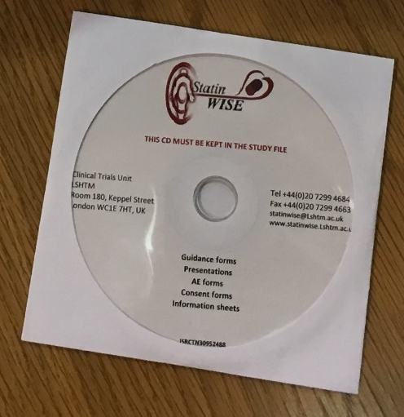
Training materials
POWERPOINT PRESENTATIONS ON CD
Front cover of the Site File
Cover various aspects of the trial:
  Rationale and Overview
  Conducting the trial at your site
  The optional Genetic study
  Maintaining your Investigator Site File
  How to search medical records?
  How to screen patients and book the Baseline visit appointment?
  How to consent patients?
  How to enter data for Nurses and GPs?
  How to enter Baseline data?
  How to enter Early Withdrawal data?
  How to enter End of Trial data?
  How to train patients on completing the questionnaires?
    How to complete the questionnaires online?
    How to complete the questionnaires on the mobile app?
    How to complete the questionnaires on paper?
    How to complete the questionnaires by phone?
  What to do if a patient develops an unexpected problem?
  Reporting Adverse Events

Slide 14


CONTACT US
London School of Hygiene & Tropical Medicine
Room 180, Keppel Street, London WC1E 7HT
Tel +44(0)20 7299 4684
Fax +44(0)20 7299 4663
Email: statinwise@Lshtm.ac.uk

