Slide 1




A series of randomised controlled N-of 1 trials in patients who have discontinued or are considering discontinuing statin use due to muscle-related symptoms to assess if atorvastatin treatment causes more muscle symptoms than placebo
RATIONALE AND OVERVIEW
Trial protocol code: ISRCTN30952488
Version 2.1, 05 December 2016

Slide 2
Background
Statins are the most commonly prescribed treatment in the UK
NICE guidelines¹ recommends statins to all patients with over 10% 10-year risk of CVD (= 2m new statins users)
Research shows high prevalence of serious adverse events (rhabdomyolysis) but many patients stop statins use due to less severe effects (muscle pain; fatigue)
¹National Institute for Health and Care Excellence Clinical Guideline CG181, September 2016

Slide 3
Statins and muscle pain Research
Statins are effective at reducing CVD risks yet patients stop treatment due to muscle symptoms
Observational unblinded studies conducted:
participants expect adverse effects and therefore reporting of symptoms may be higher than in a comparable statin-free population
This phenomenon, the “nocebo” effect, can lead to bias in unblinded studies¹
¹Barsky AJ, Saintfort R, Rogers MP, Borus JF. Nonspecific medication side effects and the nocebo phenomenon. Jama 2002; 287(5): 622-7.
Notes:
Severe statin adverse effects are extremely rare (rhabdomyolysis 0.1 and myopathy 0.5 per 1000 people over 5 years). However, there has been widespread reporting of other less well-defined statin-related symptoms in the media, notably muscle pain and weakness. These reports have largely been prompted by data from non-randomised, non-blinded observational studies, but have not been confirmed in blinded randomised controlled trials (RCTs).

Slide 4
Statins and muscle pain Research
ODYSSEY ALTERNATIVE trial
GAUSS 3 Trial
compared alirocumab with ezetimibe in patients at moderate to high cardiovascular risk with statin intolerance (unable to tolerate ≥2 statins, including one at the lowest approved starting dose) due to muscle symptoms
alirocumab vs ezetimibe vs atorvastatin
Double-blind RCT
compared lipid-lowering efficacy for ezetimibe and evolocumab in patients with muscle symptoms confirmed by statin rechallenge
ezetimibe vs atorvastatin vs evolocumab
Double-blind RCT

Slide 5
Statins and muscle pain Research ODYSSEY ALTERNATIVE Results
ODYSSEY ALTERNATIVE¹ trial (alirocumab vs ezetimibe vs atorvastatin)
statin ‘intolerant’ patients initially underwent a double blind four-week phase where they received placebo.
7% dropped out due to myalgia.
In the main phase of the trial, rates of adverse events were the same across all groups at roughly 80%, but dropped to 55% among alirocumab when unblinded
expectation of adverse effects among both placebo and active treatment arms may have diluted any true effect of statins on muscle symptoms → nocebo
¹ Moriarty PM. ODYSSEY ALTERNATIVE demonstrates complexity of statin-intolerant patients. AHA 2014; 2014.

Slide 6
Statins and muscle pain Research
GAUSS 3 Results
GAUSS 3 trial ¹ (ezetimibe vs evolocumab) in Patients With Muscle-Related Statin Intolerance
2-week washout period where patients received atorvastatin or placebo
43% reported intolerable muscle pain on atorvastatin
27% reported intolerable muscle pain on placebo → nocebo
In the main phase of the trial, muscle related events reported were 21% on evolocumab and 29% on ezetimibe
0.7% vs 7% stopped treatment due to muscle symptoms
¹ Nissen SE, Stroes E, Dent-Acosta RE, et. al. Efficacy and Tolerability of Evolocumab vs Ezetimibe in Patients With Muscle-Related Statin Intolerance The GAUSS-3 Randomized Clinical Trial. JAMA. 2016;315(15):1580-1590)
Notes:
There is very limited research into the link between statins and muscle pain. One study published earlier this year did offer insight into this problem however the study design and methods did not explicitly aim to assess the extent and magnitude of muscle symptoms.

Slide 7
Statins and muscle pain Research
Two BMJ articles^{1,2} late 2013 suggesting side effects of statins may outweigh benefits
Media coverage grew through early 2014
Number of internet searches increased³
Number of patients starting and stopping statin therapy impacted³
Impact sufficient to lead to an additional 2000 – 6000 heart attacks³
¹ BMJ 2013;347:f6123
² BMJ 2013;347:f6340
³BMJ 2016;353:i3283

Slide 8
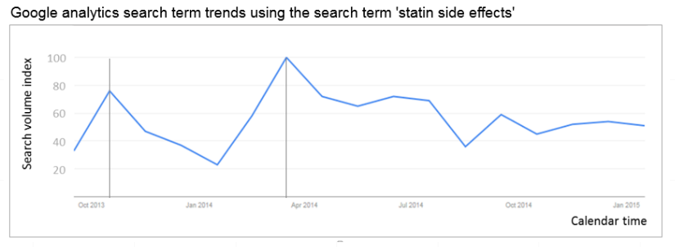

Slide 9
Number of patients stopping/starting statins when articles published

Slide 10
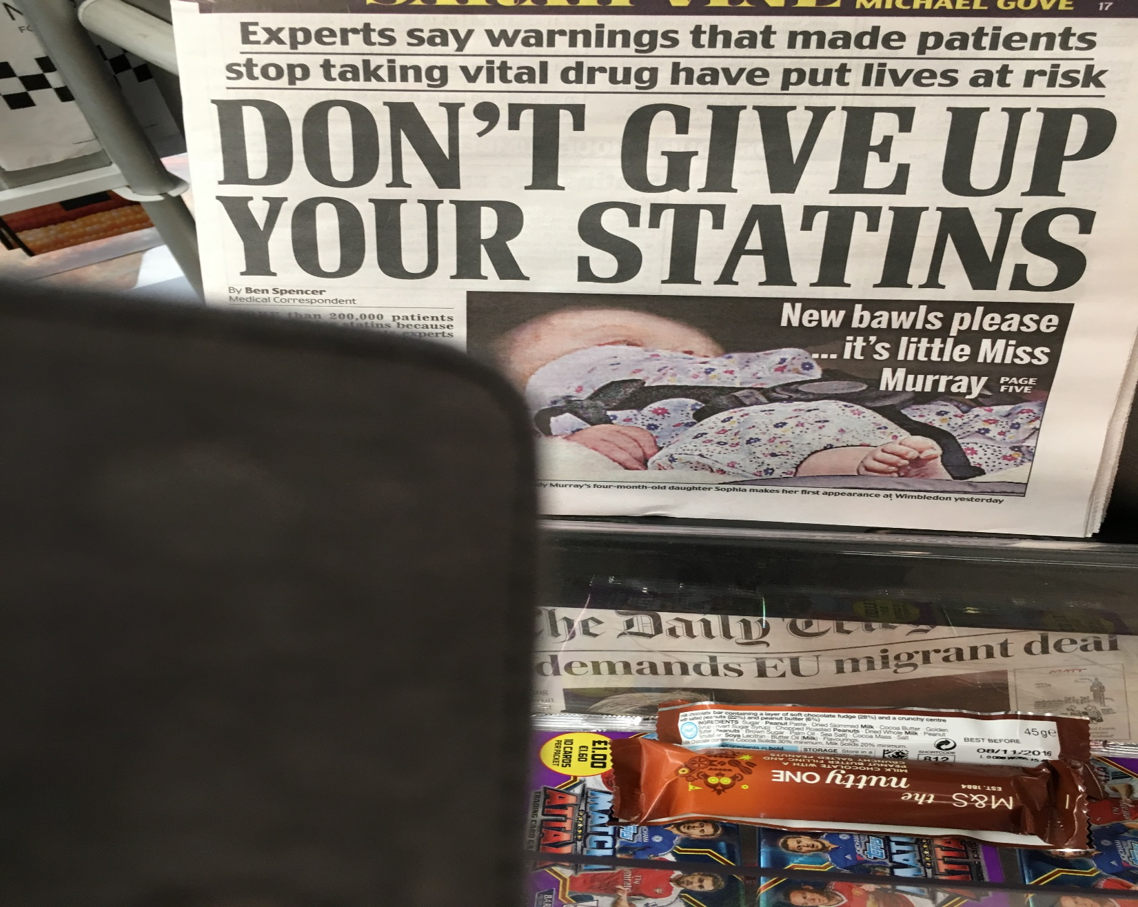

Slide 12

Why are we doing this trial?
1. Statins are effective at reducing CVD risks
2. Number of people qualifying for statin therapy increasing
3. Clinical need to address this commonly reported problem
4. Robust evidence into link between muscle pain and statin needed
The StatinWISE trial will assess whether atorvastatin 20mg treatment causes more muscle symptoms than placebo

Slide 13
StatinWISE Overview

Slide 14
Trial Team
Prof Liam Smeeth – CI and trial Medical Advisor
Haleema Shakur – Project Director
Dr Emily Herrett – Research Fellow
Dr Fizz Williamson – Statistician
Danielle Beaumont – Trial Manager
Danielle Prowse – Trial Data Manager
Collette Barrow – Trial Administrator
Dr Nabila Youssouf – Trial Manager
PPI, DMC and TSC in place

Slide 15
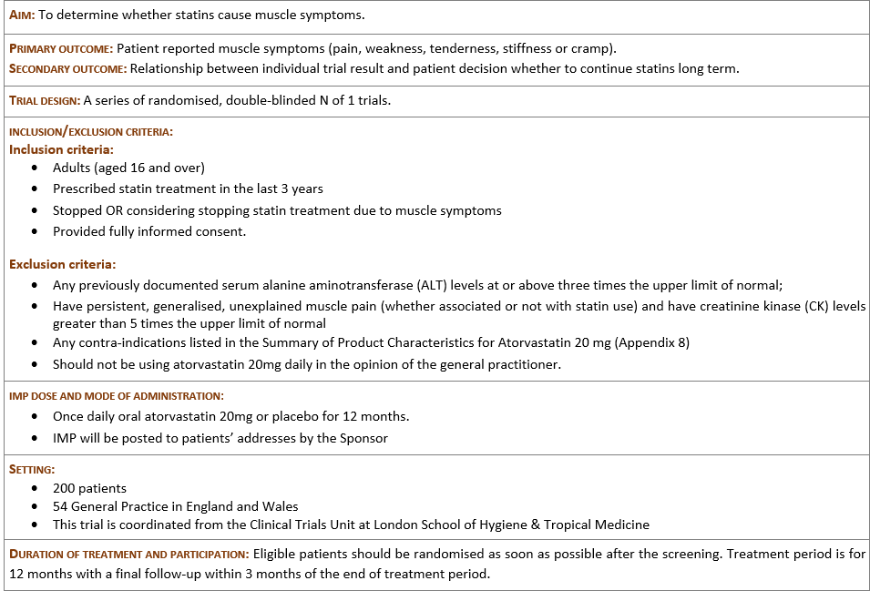


Slide 16

StatinWISE Recruitment
54 GP Practices in England and Wales
200 patients
No minimum patient recruitment
Research cost of £979 paid in quarterly instalments
Service Support cost from Network available

Slide 17
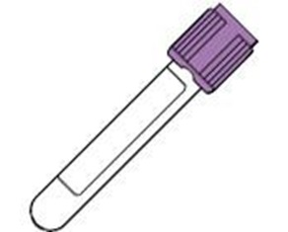
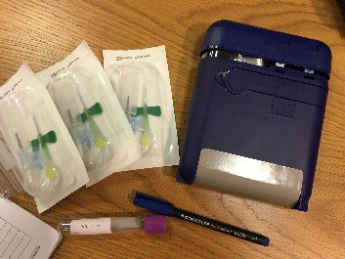
Optional Genetic Study
A genetic component to statin myopathy has been suggested: the SLCO1B1 variant however further research is required to explore this
Patient will be asked to participate in an optional genetic study by giving a single blood sample
Blood sample will be taken at Baseline and be anonymised
Tube/Butterfly and Safebox provided
Blood samples will be sent to University of Liverpool for analysis
Results will not be available to GPs or patients

Slide 18
Trial Procedures Overview
RECRUITMENT
Search list and clinical eligibility checks
PIS sent to patients
Interested patients contact Research Nurse to book Baseline visit
Assessed for eligibility
Attend screening visit
Randomised (n=200)
FOLLOW-UP
Symptoms questionnaire
to complete during days
50 to 56 of each
treatment period
Adherence to treatment
Adverse events reporting
Pain questionnaire
Confirmation of treatment pack receipt on day 56 of each treatment period
Treatment period 1: Statin or placebo
Treatment period 2: Statin or placebo
Treatment period 3: Statin or placebo
Treatment period 4: Statin or placebo
Treatment period 5: Statin or placebo
Treatment period 6: Statin or placebo
END OF TRIAL
Individual results disclosed to GP/Research Nurse and Patient (by phone or in person) and decision taken on ongoing statin therapy
Within 3 months of treatment period 6 end:
N of 1 trial results
Patient final decision will be recorded on End of Trial form

Slide 19
Trial Procedures Overview
RECRUITMENT
Search list and clinical eligibility checks
PIS sent to patients
Interested patients contact Research Nurse to book Baseline visit
GP
Assessed for eligibility
RN
RN
Attend screening visit
RN
Randomised (n=200)
12 months
FOLLOW-UP
Symptoms questionnaire
to complete during days
50 to 56 of each
treatment period
Adherence to treatment
Adverse events reporting
Pain questionnaire
Confirmation of treatment pack receipt on day 56 of each treatment period
Treatment period 1: Statin or placebo
Treatment period 2: Statin or placebo
CTU
Treatment period 3: Statin or placebo
Treatment period 4: Statin or placebo
Treatment period 5: Statin or placebo
Treatment period 6: Statin or placebo
END OF TRIAL
Individual results disclosed to GP/Research Nurse and Patient (by phone or in person) and decision taken on ongoing statin therapy
Within 3 months of treatment period 6 end:
N of 1 trial results
Patient final decision will be recorded on End of Trial form
GP

Slide 20

Trial Procedure Summary
Recruitment
Search list and clinical eligibility checks
PIS posted to patients using DOCMAIL
Interested patients contact Research Nurse to book Baseline visit

Slide 21
Trial Procedure Summary
Baseline Visit
Patient attends the site for the Baseline visit with Nurse
Nurse explains the trial and answers any questions
If patient consents to participating in the optional genetic study, a single blood sample is taken by the Nurse and posted using the Safebox provided
Informed consent must be recorded on Informed Consent form provided in Section 13 of the Investigator Site File
Baseline data is recorded on the database
The trial treatment is posted to patients by the CTU
Patient changes their mind
Patient does not meet all eligibility criteria
Patient is not randomised
Complete the Screening log
Patient meets all eligibility criteria
Patient is randomised
Complete the Screening and Randomisation logs
Notes:
A separate presentation for taking informed consent is available.
Please remember that patients do not have to consent to the genetic study: the consent form is in 2 parts. They can simply consent to the main StatinWISE study only
A separate presentation explaining the optional genetic study and its procedure is available.
A separate presentation for access to the trial database and how to enter data is available.

Slide 22
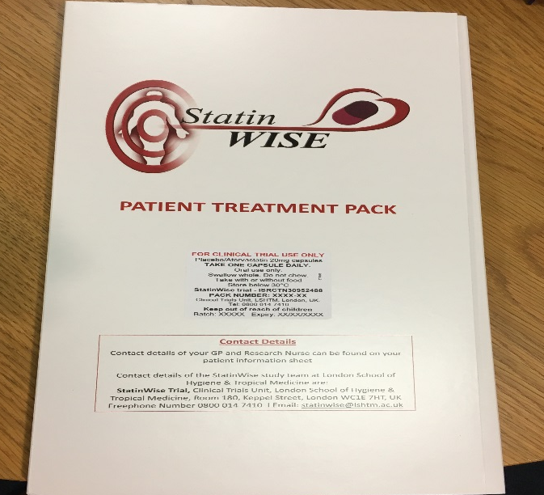
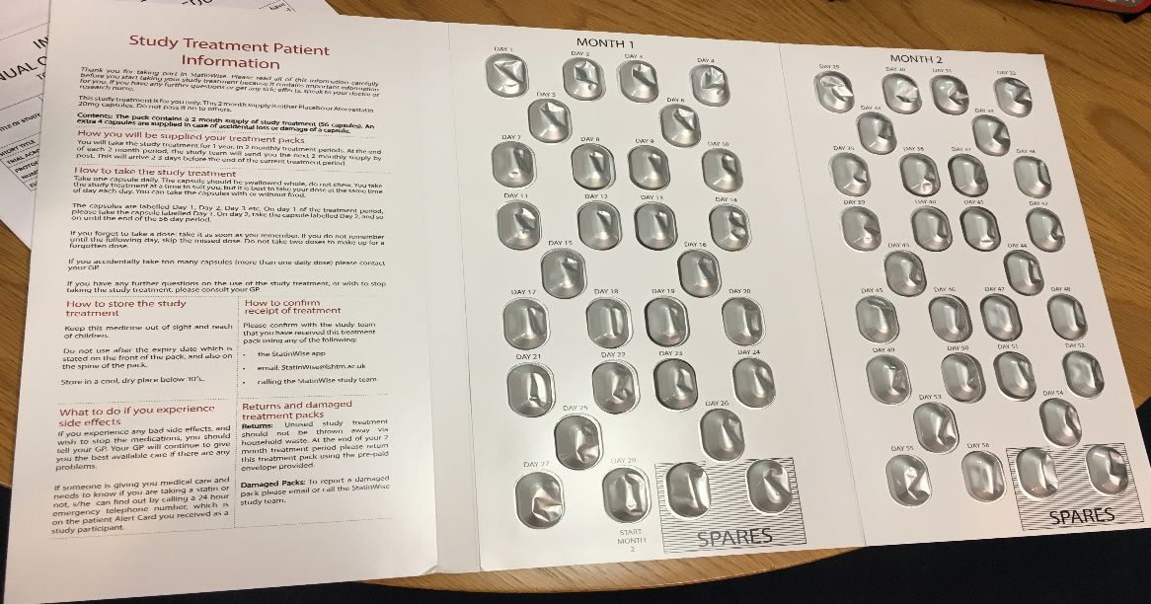
Statinwise Treatment
Atorvastatin 20 mg and matching placebo
Capsule form to be taken anytime once daily
3x 2 months taking statins followed by 3x 2 months on placebo in any order (double-blind)
Treatment will be posted by CTU to patients addresses in 2-months treatment packs
Notes:
The treatment packs fit through a standard letterbox.
A self-addressed envelope is enclosed with each treatment packs for patients to return their used treatment packs at the end of each treatment period

Slide 23
Trial Procedure Summary
Data Collection
Symptoms questionnaire to complete directly by patients during days 50 to 56 of each treatment period only
Data collected is:
Data collection methods are:
  Adherence to treatment
  Adverse events reporting
  Pain questionnaire
  Mobile application (app) or
  Online or
  Phone or
  Paper
Notes:
Separate presentations explaining how to complete the questionnaires are available

Slide 24
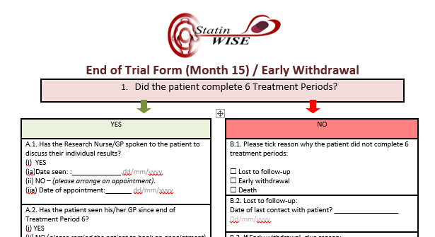
Trial Procedure Summary
End of Trial
Individual results disclosed to GP/Research Nurse and Patient (by phone or in person)
Decision taken on ongoing statin therapy
End of Trial form is completed online by GP/Nurse
Notes:
The End of Trial CRF is also completed if the patient withdraws early.
A separate presentation explaining how to enter End of Trial/ Early withdrawal data is available

Slide 25
StatinWISE Data Collection
Time points Summary
Data | When | Completed by | Data entry method
Baseline | Screening visit | Research Nurse or GP | Online
Patient questionnaires | Every 2 months for 1 week | Patient | Mobile application (app) or Online or Phone or Paper
End of Trial/ Early Withdrawal | Month 15 or at time of earlier withdrawal | Research Nurse or GP | Online
Adverse event | As required | Research Nurse or GP | Online or Paper form

Slide 26
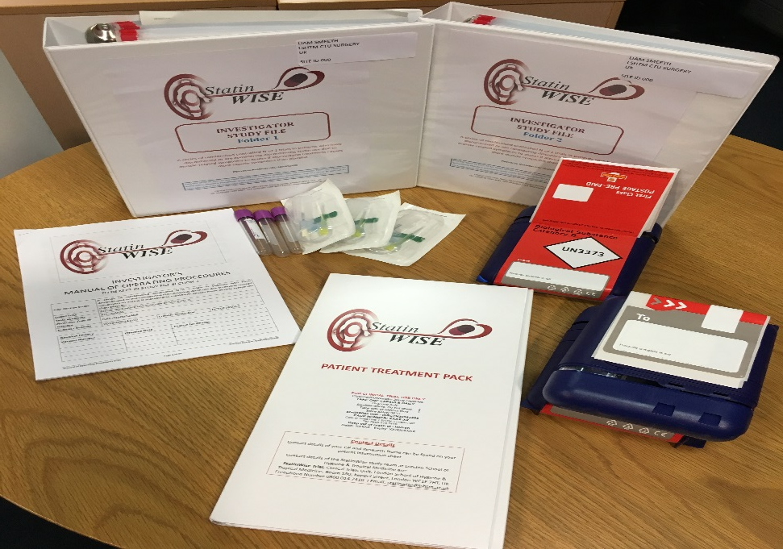
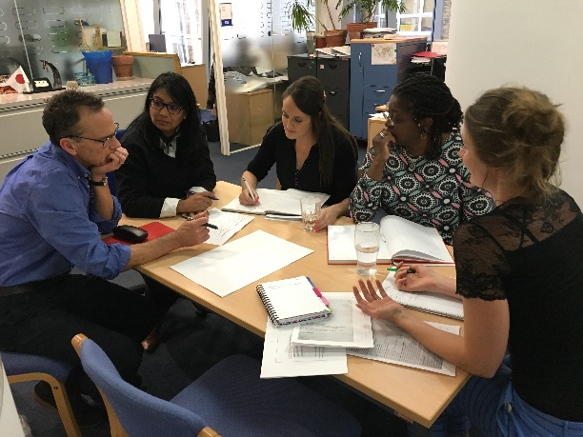
Trial Materials
BEFORE YOU START THE TRIAL YOU WILL RECEIVE:
a study file compiled specifically for your
site, containing contact details,
further information, guidance, spare
consent and AE forms and filing space
for completed forms
training CD with PowerPoint
presentations
TRAINING AND PRESENTATIONS
Please contact the CTU if
you need more training materials for
staff sessions
you are presenting the trial at meetings
or conferences

Slide 27

StatinWISE aims to:
Answer an important question for
public health
Answer the question for individual
patients
Bring together research and
care
As little work as possible for
GPs Practices

Slide 28

CONTACT US
London School of Hygiene & Tropical Medicine
Room 180, Keppel Street, London WC1E 7HT
Tel +44(0)20 7299 4684
Fax +44(0)20 7299 4663
Email: statinwise@Lshtm.ac.uk

